Slide 1
Christian Culture or Christian Identity

Slide 2
Historical Reasons to Worry
Crusades Christians fighting a Holy War
Southern Baptist Convention Many strong biblical churches and leaders are in the SBC. But it was formed because northern Baptists refused to send slave-owners to do overseas missions work

Slide 3
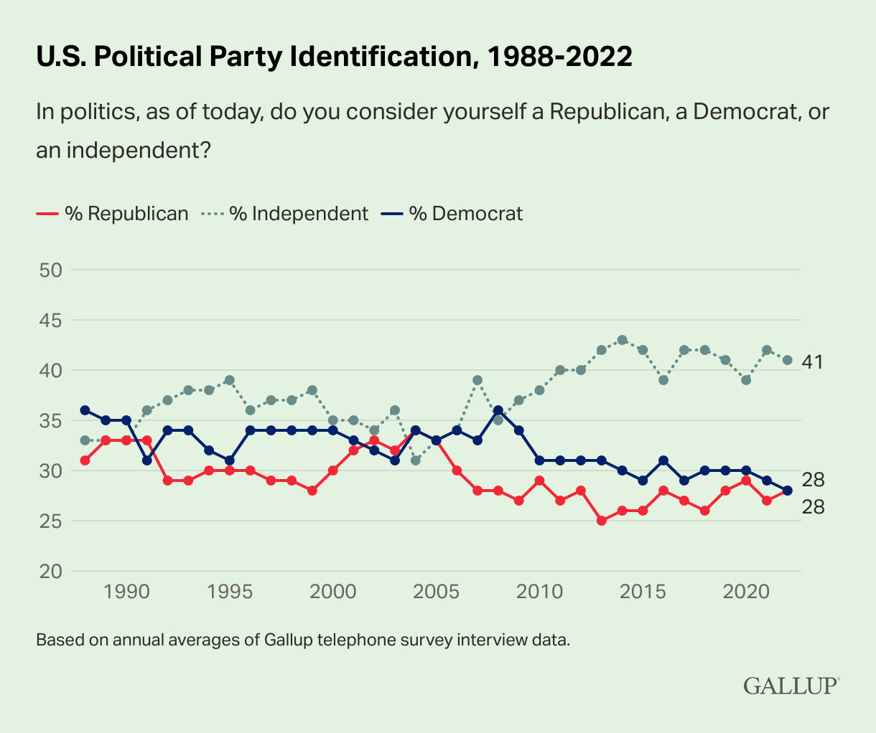
Contemporary Reasons to Worry
People associate Christianity with GOP, but recently “evangelical” has become another word for Republican.
Lesson Bold, noisy political identification will place you across from 72% of the nation.

Slide 4
Contemporary Reasons to Worry
A couple of months before we left [for Sudan], I received a Christian news publication in the mail. The front cover had two headlines side by side…

Slide 5
Contemporary Reasons to Worry
On the left one headline read, “First Baptist Church Celebrates New $23 Million Building.” A lengthy article followed, celebrating the church’s expensive new sanctuary. The exquisite marble, intricate design, and beautiful stained glass were all described in vivid detail.
On the right was a much smaller article. The headline for it read, “Baptist Relief Helps Sudanese Refugees.” Knowing I was about to go to Sudan, my attention was drawn.

Slide 6
Contemporary Reasons to Worry
The article described how 350,000 refugees in western Sudan were dying of malnutrition and might not live to the end of the year. It briefly explained their plight and sufferings. The last sentence said that Baptists had sent money to help relieve the suffering of the Sudanese. I was excited until I got to the amount.
Now, remember what was on the left: “First Baptist Church Celebrates New $23 Million Building.” …

Slide 7
Contemporary Reasons to Worry
On the right the article said, “Baptists have raised $5,000 to send to refugees in western Sudan.”
Five thousand dollars.
That is not enough to get a plane into Sudan, much less one drop of water to people who need it.
Where have we gone wrong?
How did we get to the place where this is actually tolerable?

Slide 8
Biblical Reasons to Worry
Words of Jesus
In the World, Not of the World “My prayer is not that you take them out of the world but that you protect them from the evil one. They are not of the world, even as I am not of it.” [Jn 17:15-16]
Render Unto Caesar “Is it right for us to pay taxes to Caesar or not?” He saw through their duplicity and said to them, “Show me a denarius. Whose image and inscription are on it?” “Caesar’s,” they replied. He said to them, “Then give back to Caesar what is Caesar’s, and to God what is God’s.” [Lk 20:22-25]

Slide 9
Biblical Reasons to Worry
Words of Paul
All Things to All People Though I am free and belong to no one, I have made myself a slave to everyone, to win as many as possible. To the Jews I became like a Jew, to win the Jews. To those under the law I became like one under the law (though I myself am not under the law), so as to win those under the law. To those not having the law I became like one not having the law (though I am not free from God’s law but am under Christ’s law), so as to win those not having the law.[1 Cor 9:19-21]

Slide 10
What I’m NOT Saying
That you should rid yourself of all cultural trappings–that’s impossible.
That you can’t hold conservative Christian values, or vote a certain way. (Cf. Jerusalem church)
That we should create new Christian culture defined by entirely by its rejection of current Christian culture

Slide 11
From Culture to Identity
Cultural forms are by their nature social constructions–not necessarily bad, until they divide us. (Cf. Gal 6:15)
God also divides us, but in a way that ironically unites us:
In Adam You plan to present to God what you’ve inherited and created in yourself. All start here.
In Christ You plan to present Jesus to God. All may go here.
Jesus will “baptize” using fire, and the Holy Spirit. (Mt 3:11)

Slide 12
From Culture to Identity
Hypocritical for Christians to…
Sneer at people far from God–we are all alike under condemnation in Adam!
Boast in anything other than the cross of Christ (Gal 6:14)
Qualifier You should feel free to enjoy your own culture, race, gender, etc. (Rev 7:9) New creation doesn’t destroy old creation, it sanctifies it. New identity precludes snobbery.

Slide 13
From Culture to Identity
When you know you received life when you deserve death, YOU ARE FREE TO…
Lay aside your desires, preferences to love (Cf. Phil 2:3,4)
Sympathize with those away from God, because you were too (Rom 5:6-11)
Share earnestly what you’ve discovered

Slide 14
Between Culture and Identity
 | Culture | Identity
Highest Value | Protection | Love (Mk 12:28-31)
Source of Truth | Cable News, Twitter | Scripture (2 Tim 3:16)
Power Source | Political Levers | Holy Spirit (Acts 1:8)
Insiders | “Shibboleths” | Unity (Eph 4:3)
Outsiders | Danger | Love, Prayer (Mt 5:44)
Culture | Identity | Kingdom Tool (1Co9)

Slide 15
Between Culture and Identity
 | Culture | Identity
Highest Value | Protection | Love (Mk 12:28-31)
Source of Truth | Cable News, Twitter | Scripture (2 Tim 3:16)
Power Source | Political Levers | Holy Spirit (Acts 1:8)
Political Power | Wielded | Yielded (Jn 19:11)
Secular Gov’t | Subvert | Submit (Rom 13:5)
Citizenship | United States | Heaven (Phil 3:20)

Slide 16
Practicals
Develop Deep Biblical Worldview
You are being inundated with calls to be outraged, to take a side, to adopt an outlook. These are matters of the mind, matters of the heart, a persistent theme in Scripture (e.g.s Deut 10:12,16; 1 Sam 16:7; Prov 26:12; Jer 17:9; Mk 7:20-23; Rom 1:18ff, 8:5-7, 12:2; Phil 4:8; Col 3:1-3)

Slide 17
Practicals
Develop Deep Biblical Worldview
You Are What You Eat
Psalm 1:1-3 Blessed is the one who does not walk in step with the wicked or stand in the way that sinners take or sit in the company of mockers, but whose delight is in the law of the Lord, and who meditates on his law day and night. That person is like a tree planted by streams of water, which yields its fruit in season and whose leaf does not wither- whatever they do prospers.

Slide 18
Practicals
Develop Deep Biblical Worldview
Whole Bible Reading, Portrait of Old, New Identity
Avoid being a “poseur”. Your power is the Spirit, not mere adaptability (Cf. Chuck Smith)
How are you influenced by your local church culture, not by your identity in Christ?

