Slide 1
PROVERBS
Spiritual Friendships

Slide 2
Why study friendships?
Many young people are lonely

Slide 3
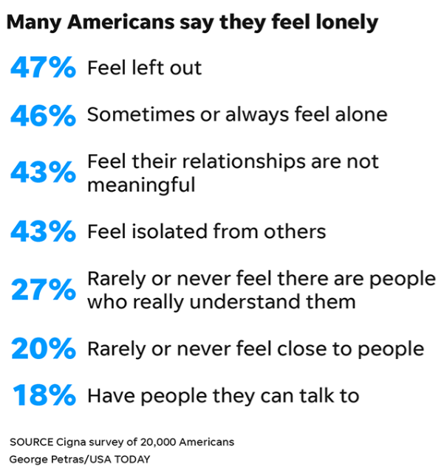
Why study friendships?
Many young people are lonely

Slide 4
Why study friendships?
Many young people are lonely
“Jesus’ biggest miracle was that he had 12 close friends at age 30.”

Slide 5
The younger people, part of Generation Z, had loneliness scores of about 48 compared with nearly 39 of those 72 and older…
More than half of these 18- to 24-year-old members of Gen Z identified with 10 of the 11 feelings associated with loneliness.
The Cigna Group
“2018 Cigna U.S. Loneliness Index”

Slide 6
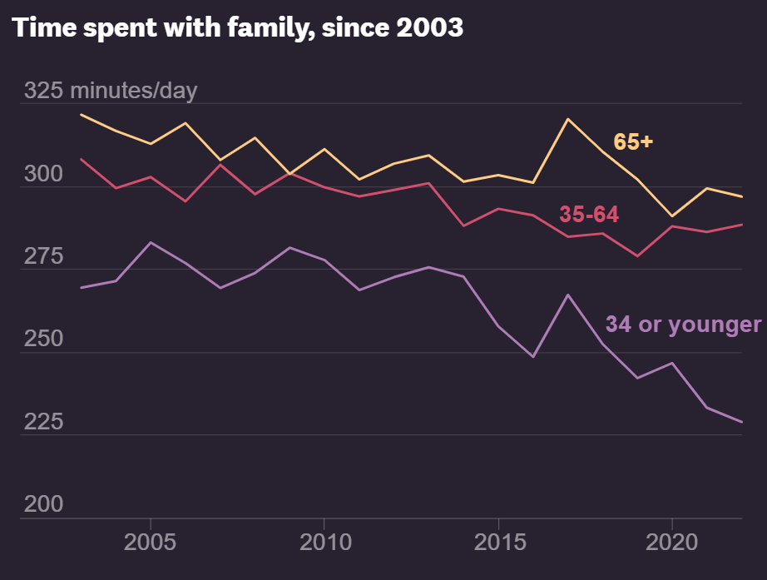

Slide 7
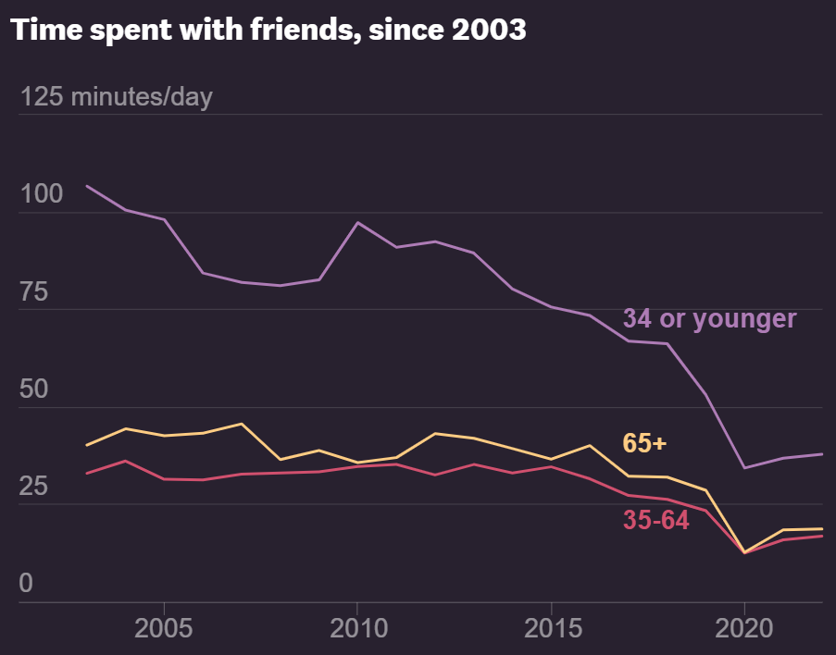

Slide 8
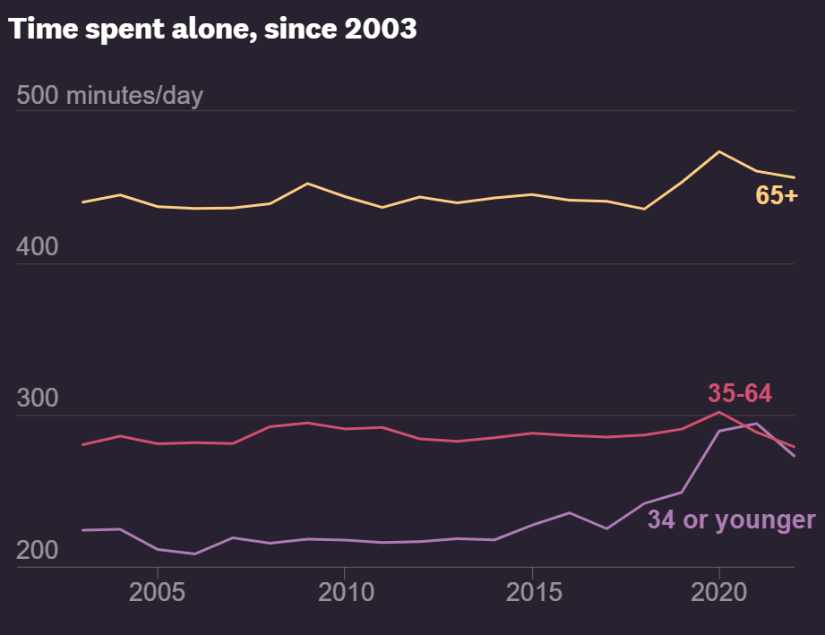

Slide 9
I have students who tell me they have 500 ‘friends,’
but when they’re in need, there’s no one.
Dr. Jagdish Khubchandani
Professor of Health Science

Slide 10
Loneliness and social isolation increase the risk for premature death by 26% and 29% respectively…
More broadly, lacking social connection can increase the risk for premature death by as much as smoking up to 15 cigarettes a day.
Dr. Vivek Murthy
Physician and former Surgeon General

Slide 11
In addition, poor or insufficient social connection is associated with of disease [such as heart attack or stroke]…increased risk for anxiety, depression and dementia.
We need good friends!
Dr. Vivek Murthy
Physician and former Surgeon General

Slide 12
Why study friendships?
Many young people are lonely
Relationships are hard

Slide 13
To love at all is to be vulnerable.
Love anything and your heart will be wrung and possibly broken.
If you want to make sure of keeping it intact you must give it to no one, not even an animal.
Lock it up safe in the casket or coffin of your selfishness.
CS Lewis
Christian Author
The Four Loves

Slide 14
But in that casket, safe, dark, motionless, airless, it will change.
It will not be broken; it will become unbreakable, impenetrable, irredeemable.
To love is to be vulnerable.
CS Lewis
Christian Author
The Four Loves

Slide 15
Why study friendships?
Many young people are lonely
Relationships are hard
Your friendships may define your life

Slide 16
Why study friendships?
Proverbs 13:20 – ²⁰Walk with the wise and become wise, for a companion of fools suffers harm.
Many young people are lonely
Relationships are hard
Your friendships may define your life
1 Corinthians 15:33 – ³³Do not be misled: “Bad company corrupts good character.”

Slide 17
Why study friendships?
Many young people are lonely
Relationships are hard
Your friendships may define your life
What are qualities to look for in friendships?
Proverbs 12:26 – ²⁶The righteous choose their friends carefully, but the way of the wicked leads them astray.

Slide 18
Proverbs 9
¹⁰The fear of the LORD is the beginning of wisdom, and knowledge of the Holy One is understanding.
¹¹For through knowledge your days will be many, and years will be added to your life.
God gives you the wisdom and power to love
1 John 4:19 – ¹⁹We love because he first loved us.
#1
GOD-CENTERED

Slide 19
People without God…hang too much on their personal relationships, and they crush and break.
No love affair between a man and woman has ever been great enough to hang everything on.
It will crumble under your feet…
Francis Schaeffer
Christian Author
True Spirituality

Slide 20
If I acknowledge that I am not really God, and that since the fall we are all sinful,
then I can have true human relationships without battering myself to pieces because they are not sufficient in themselves, or because they are not perfect.
Francis Schaeffer
Christian Author
True Spirituality

Slide 21
Proverbs 23
⁷For as he thinks within himself, so he is.
God is able and eager to transform you
#1
GOD-CENTERED

Slide 22
Proverbs 17
¹⁷A friend loves at all times.
The key to successful relationships is love output, not love input
#2
OTHERS-CENTERED

Slide 23
Proverbs 11
¹⁷Those who are kind benefit themselves, but the cruel bring ruin on themselves.
How can we practice being others-centered?
#2
OTHERS-CENTERED

Slide 24
Proverbs 20
⁵The purposes of a person’s heart are deep waters, but one who has insight draws them out.
Tips to draw others out:
Come prepared with questions (Heb. 10:24)
Learn to ask questions on top of questions
Treat attention as an on/off switch, not a dimmer
#2
OTHERS-CENTERED

Slide 25
We’ve all had the experience of telling somebody something and noticing that they are not really listening.
It feels like you’re sending a message out to them and they’re just letting it fly past.
David Brooks
Secular Author
How to Know a Person

Slide 26
The problem is that the average person speaks at the rate of about 120 to 150 words a minute,
which is not nearly enough data to occupy the brain of the person being spoken to.
David Brooks
Secular Author
How to Know a Person

Slide 27
If you are socially anxious, you probably have so many thoughts about yourself dancing around in your head,
they threaten to hijack your attention from whatever the person in front of you is saying.
David Brooks
Secular Author
How to Know a Person

Slide 28
The solution as a listener is to treat attention as all or nothing.
If you’re here in this conversation, you’re going to stop doing anything else and just pay attention to this.
David Brooks
Secular Author
How to Know a Person

Slide 29
You’re going to apply what some experts call the SLANT method:
Sit up
Lean forward
Ask questions
Nod your head
Track the speaker
David Brooks
Secular Author
How to Know a Person

Slide 30
Listen with your eyes.
That’s paying attention 100 percent.
Good relationships require more than being around people
David Brooks
Secular Author
How to Know a Person

Slide 31
Proverbs 27
¹⁷As iron sharpens iron, so one person sharpens another.
⁶Wounds from a friend can be trusted, but an enemy multiplies kisses.
We tend to take feedback the worst possible way
#3
ACCOUNTABILITY

Slide 32
Like that comment your spouse made a moment ago: “I don’t like the way those pants look on you.”
What do you mean, you don’t like the way these pants look on me?
Douglas Stone & Sheila Heen
Secular Authors
Thanks for the Feedback

Slide 33
Is there something wrong with this particular pair of pants,
or was that a passive-aggressive reference to the weight I’ve put on?
Another dig about how I’m living in the past or can’t dress myself, even as an adult?
Douglas Stone & Sheila Heen
Secular Authors
Thanks for the Feedback

Slide 34
Are you trying to help me look nice for the party,
or is this your way of easing into asking for a divorce?
What do you mean I’m overreacting?
If you don’t get much feedback, it’s probably because of you, not them.
Douglas Stone & Sheila Heen
Secular Authors
Thanks for the Feedback

Slide 35
Proverbs 27
¹⁷As iron sharpens iron, so one person sharpens another.
⁶Wounds from a friend can be trusted, but an enemy multiplies kisses.
Markers you receive feedback well:
Respond with questions, not defensiveness
More concerned with content than delivery
Prays rather than complains
#3
ACCOUNTABILITY

Slide 36
There is an old joke about a happy young optimist whose parents are trying to teach him to see the world more realistically.
To that end, they decide to give him a large sack of horse dung for his birthday.
Douglas Stone & Sheila Heen
Secular Authors
Thanks for the Feedback

Slide 37
“What did you get?” asks his grandmother, wrinkling her nose at the smell.
“I don’t know,” cries the boy with delight as he excitedly digs through the dung,
“but I think there’s a pony in here somewhere!”
Douglas Stone & Sheila Heen
Secular Authors
Thanks for the Feedback

Slide 38
Receiving feedback can be like that.
It’s not always pleasant.
But there just might be a pony in there somewhere.
Douglas Stone & Sheila Heen
Secular Authors
Thanks for the Feedback

Slide 39
Proverbs 20
⁶Many claim to have unfailing love, but a faithful person who can find?
#4
LOYALTY

Slide 40
During my first days at Smith [College],
I witnessed countless conversations that consisted of one person telling the other that their opinion was wrong.
Greg Lukianoff & Jonathan Haidt
Secular Authors
The Coddling of the American Mind

Slide 41
The word “offensive” was almost always included in the reasoning.
Within a few short weeks, members of my freshman class had quickly assimilated to this new way of non-thinking.
Greg Lukianoff & Jonathan Haidt
Secular Authors
The Coddling of the American Mind

Slide 42
They could soon detect a politically incorrect view and call the person out on their “mistake.”
I began to voice my opinion less often to avoid being berated and judged by a community that claims to represent the free expression of ideas.
Greg Lukianoff & Jonathan Haidt
Secular Authors
The Coddling of the American Mind

Slide 43
I learned, along with every other student, to walk on eggshells for fear that I may say something “offensive.”
That is the social norm here.
Greg Lukianoff & Jonathan Haidt
Secular Authors
The Coddling of the American Mind

Slide 44
Proverbs 20
⁶Many claim to have unfailing love, but a faithful person who can find?
Loyal friendships:
Interpret intentions charitably (Prov. 10:12)
Stick with people even in disagreement (Prov. 17:17)
Are present in times of need (Prov. 18:24)
#4
LOYALTY

Slide 45
Proverbs 20
Proverbs 10:12 – ¹²Hatred stirs up conflict, but love covers all wrongs.
⁶Many claim to have unfailing love, but a faithful person who can find?
Proverbs 17:17 – ¹⁷A friend loves at all times, and a brother is born for a time of adversity.
Loyal friendships:
Interpret intentions charitably (Prov. 10:12)
Stick with people even in disagreement (Prov. 17:17)
Are present in times of need (Prov. 18:24)
Proverbs 18:24 – ²⁴One who has unreliable friends soon comes to ruin, but there is a friend who sticks closer than a brother.
#4
LOYALTY

Slide 46
Proverbs 19
¹¹A person’s wisdom yields patience; it is to one’s glory to overlook an offense.
Ephesians 4:32 – ³²Be kind and compassionate to one another, forgiving each other, just as in Christ God forgave you.
#5
FORGIVING

Slide 47
Conclusions
Many young people are lonely
But you don’t have to be
Start a relationship with God
Dive deeper into Christian community

Slide 48
Conclusions
Many young people are lonely, but you don’t have to be
Relationships are hard
But rewarding
Focus on becoming a servant

Slide 49
Conclusions
Many young people are lonely, but you don’t have to be
Relationships are hard, but rewarding
Your friendships may define your life
So choose wisely
You will rarely dip below the quality of your friends
But you will rarely rise above them either

Slide 50
Conclusions
Proverbs 13:20 – ²⁰Walk with the wise and become wise, for a companion of fools suffers harm.
Many young people are lonely, but you don’t have to be
Relationships are hard, but rewarding
Your friendships may define your life
So choose wisely
You will rarely dip below the quality of your friends
But you will rarely rise above them either

Slide 51
PROVERBS
Spiritual Friendships

