Slide 1
EPHESIANS
THE BOOK OF

Slide 2
Ephesians 5
¹⁵ Be very careful, then, how you live—not as unwise but as wise,
¹⁶ making the most of every opportunity, because the days are evil.

Slide 3
Ephesians 5
¹⁸ Do not get drunk on wine, which leads to debauchery.
This would extend to all forms of alcohol.

Slide 4
Ephesians 5
¹⁸ Do not get drunk on wine, which leads to debauchery.
This would extend to all forms of alcohol.

Slide 5
Are Christians allowed to drink?
» Many churches have prohibited alcohol consumption.
“If drinking can lead to alcoholism, why not eliminate the danger?”

Slide 6
Are Christians allowed to drink?
» What does the Bible say about alcohol?
Psalm 104:15: [God made] wine which makes man’s heart glad.
Deuteronomy 14:26: You may spend the money for whatever your heart desires: for oxen, or sheep, or wine, or strong drink, or whatever your heart desires; and there you shall eat in the presence of the LORD your God and rejoice, you and your household.

Slide 7
Are Christians allowed to drink?
» What does the Bible say about alcohol?
Some have suggested that these references to wine are actually grape juice or “new wine.”
Jesus turned water into wine (John 2).
Luke 7:33-34: For John the Baptist came neither eating bread nor drinking wine, and you say, ‘He has a demon.’ The Son of Man came eating and drinking, and you say, ‘Here is a glutton and a drunkard.
Wine = oinos

Slide 8
Are Christians allowed to drink?
» What does the Bible say about drunkenness?
Proverbs 23:29-35: Who has anguish? Who has sorrow? Who is always fighting? Who is always complaining? Who has unnecessary bruises? Who has bloodshot eyes? It is the one who spends long hours in the taverns, trying out new drinks. Don’t gaze at the wine, seeing how red it is, how it sparkles in the cup, how smoothly it goes down. For in the end it bites like a poisonous snake; it stings like a viper. Your eyes will see strange sights, and your mind will imagine confusing things…

Slide 9
Are Christians allowed to drink?
» What does the Bible say about drunkenness?
Proverbs 23:29-35: You will stagger like a sailor tossed at sea, clinging to a swaying mast. And you will say, “They hit me, but I didn’t feel it. I didn’t even know it when they beat me up. When will I wake up?

Slide 10
Are Christians allowed to drink?
» What does the Bible say about drunkenness?
Proverbs 23:29-35: You will stagger like a sailor tossed at sea, clinging to a swaying mast. And you will say, “They hit me, but I didn’t feel it. I didn’t even know it when they beat me up. When will I wake up? So I can find another drink.
Proverbs 20:1 – Wine is a mocker, strong drink [barley beer] a brawler, and whoever is intoxicated by it is not wise.

Slide 11
Are Christians allowed to drink?
» What does the Bible say about drunkenness?
Romans 13:13 – Let us behave properly as in the day, not in carousing and drunkenness, not in sexual promiscuity and sensuality, not in strife and jealousy.
1 Peter 4:3 – For the time already past is sufficient for you to have carried out the desire of the [nations], having pursued a course of sensuality, lusts, drunkenness, carousing, drinking parties.

Slide 12
Are Christians allowed to drink?
» What does the Bible say about drunkenness?
» Drunkenness can disqualify you from your service to God (1 Timothy 3).
» It may reinforce negative stereotypes people have about Christians (Ephesians 5:7-9).
» You might make a life altering decision while drunk (Proverbs 20:1).

Slide 13
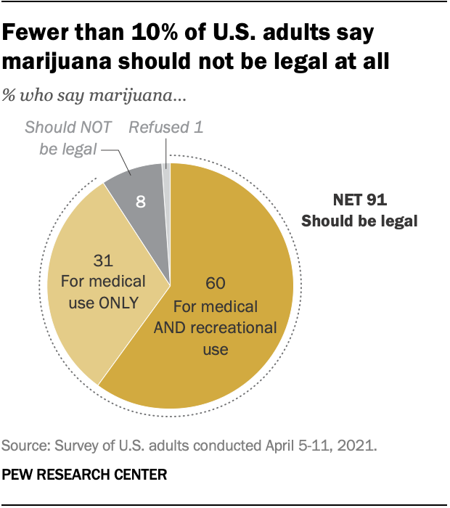
What about rec. marijuana?
» “That’s why I don’t drink, I just get high.”
73% of Americans in the 1990s believed recreational marijuana use should not be legal.
Jacob Felson, Amy Adamczyk, and Christopher Thomas, Social Science Research, “How and why have attitudes about cannabis legalization changed so much?” Volume 78, February 2019, pp 12-27

Slide 16
8x stronger!
The difference between
a 12-ounce glass of Budweiser,
and a 12-ounce glass of Bacardi!

Slide 19
What about rec. marijuana?
» Some Christians argue that the Bible never says it’s wrong to use marijuana.
The Bible affirms that “all of God’s creation is good” (1 Timothy 4:4).
God created “seed-bearing plants” and declared it “good” (Genesis 1:27).
Marijuana is a seed-bearing plant; therefore marijuana is good.
Alcohol is worse than marijuana.

Slide 20
What about rec. marijuana?
» Biblical and Scientific Case Against Recreational Marijuana Use
Silence is not affirmation.

Slide 21
What about rec. marijuana?
» Biblical and Scientific Case Against Recreational Marijuana Use
Silence is not affirmation.
The context of 1 Timothy 4:4 is about people who are teaching that you can’t eat certain foods.

Slide 22
What about rec. marijuana?
» Biblical and Scientific Case Against Recreational Marijuana Use
3. Marijuana can lead to cognitive damage
Regular users under the age of 18 had a permanent 8-point drop in their IQ over a 25-year period.
Madeline H. Meier et al., “Persistent cannabis users show neuropsychological decline from childhood to midlife,” Proceedings of the National Academy of Sciences 109, no. 40 (2012): E2657-E2664.
Kevin P. Hill, M.D., Marijuana: The Unbiased Truth about the World’s Most Popular Weed (Center City, MN: Hazelden Publishing, 2015), p.47.

Slide 23
What about rec. marijuana?
» Biblical and Scientific Case Against Recreational Marijuana Use
3. Marijuana can lead to cognitive damage and exacerbate mental illness.
The brain naturally produces an endocannabinoid (which makes dopamine). THC mimics this endocannabinoid, which shuts off the brain’s natural function.
Arpana Agrawal et al., “Major Depressive Disorder, Suicidal Thoughts and Behaviours, and Cannabis Involvement in Discordant Twins: A Retrospective Cohort Study,” The Lancet Psychiatry 4, no. 9 (2017): 706-714.

Slide 26
What about rec. marijuana?
» Biblical and Scientific Case Against Recreational Marijuana Use
3. Marijuana can lead to cognitive damage and exacerbate mental illness.
“I don’t get high that often.”
Hans Breiter (professor of psychiatry and behavioral sciences) says, “People think a little recreational use shouldn’t cause a problem, if someone is doing OK with work or school…

Slide 27
What about rec. marijuana?
» Biblical and Scientific Case Against Recreational Marijuana Use
3. Marijuana can lead to cognitive damage and exacerbate mental illness.
“I don’t get high that often.”
Hans Breiter (professor of psychiatry and behavioral sciences) says, “Our data directly says this is not the case.”
Hans Breiter, “Casual Marijuana Use Linked to Brain Abnormalities in Students.” Science Newsline (April 2014).

Slide 28
What about rec. marijuana?
» Biblical and Scientific Case Against Recreational Marijuana Use
4. Scripture speaks against intoxication and calls believers to mental sobriety.
1 Peter 5:8: Be alert and of sober mind. Your enemy the devil prowls around like a roaring lion looking for someone to devour.

Slide 29
What are the driving forces?
» Escape
» Social lubricant
» Feelings of Euphoria

Slide 30
Ephesians 5
¹⁸ Do not get drunk on wine, which leads to debauchery. Instead, be filled with the Spirit
» Paul is not implying that the Spirit is a substance that we can be filled with, like wine.
» His presence in our lives can produce genuine exhilaration that alcohol can only cheaply manufacture.

Slide 31
Ephesians 5
¹⁸ Do not get drunk on wine, which leads to debauchery. Instead, be filled with the Spirit
» What does it mean, exactly, to be filled with the Spirit?
Spiritual Empowerment
Being under the influence of the Spirit

Slide 32
Ephesians 5
¹⁹ Speaking to one another in psalms and hymns and spiritual songs, singing and making melody with your heart to the Lord.
QUESTION: Is Paul commanding us to engage in corporate singing?
ANSWER: Not necessarily

Slide 33
Ephesians 5
¹⁹ Speaking to one another in psalms and hymns and spiritual songs, singing and making melody with your heart to the Lord.
“to yourselves” (see NLT, KJV, and NASB footnote).

Slide 34
Ephesians 5
¹⁹ Speaking to one another in psalms and hymns and spiritual songs, singing and making melody with your heart to the Lord.
QUESTION: Why don’t we sing?
ANSWER: We don’t want guests, who don’t consider themselves Christians, to feel like they are expected to sing praises to a God they don’t believe.

Slide 35
Ephesians 5
¹⁹ Speaking to one another in psalms and hymns and spiritual songs, singing and making melody with your heart to the Lord.
QUESTION: Why don’t we sing?
ANSWER: Some of the better Christian songs are hundreds of years old.

Slide 36
Ephesians 5
¹⁹ Speaking to one another in psalms and hymns and spiritual songs, singing and making melody with your heart to the Lord.
We should be active in setting our minds on the things of the Spirit.

Slide 37
Ephesians 5
²⁰ Always giving thanks for all things in the name of our Lord Jesus Christ to God, even the Father.
Exercising Gratitude
» Forces us to look away from the negative and to focus on what God has done for us.
» Helps us remember what God has done for us, which leads to happiness and contentment
» May be difficult to cultivate if we have established a mental pattern of grumbling.

Slide 38
Ephesians 5
²⁰ Always giving thanks for all things in the name of our Lord Jesus Christ to God, even the Father.
Exercising Gratitude
» Most of us will need to fight to cultivate a mindset of gratitude.

Slide 39
Summary
» It’s not enough to resist, you must replace.
“Do not get drunk on wine…Instead, be filled with the Spirit” (5:18)

Slide 40
Summary
» It’s not enough to resist, you must replace.
Flee the evil desires of youth and pursue righteousness, faith, love and peace (2 Timothy 2:22).

Slide 41
Summary
» It’s not enough to resist, you must replace.
» God wants you to fill the emptiness you feel with the relational and spiritual side of life, not substances.
» Only God’s presence in your life will fill the void you feel.

Slide 42
EPHESIANS
THE BOOK OF

