Slide 1
Northern Ethiopia
14 How, then, can they call on the one they have not believed in? And how can they believe in the one of whom they have not heard? And how can they hear without someone preaching to them? 15 And how can anyone preach unless they are sent?
Romans 10:14-15

Slide 2
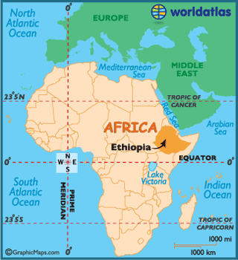

Slide 3
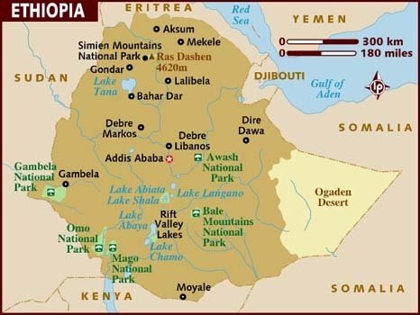

Slide 4
Northern Ethiopia
>50 Million Amhara and Tigray people < 0.5% Reached
The Site of All the Ancient Kingdoms
Birthplace of Orthodoxy and the Political and Cultural Identity of Ethiopia
These Two People Groups are the Largest Unreached in Africa

Slide 5
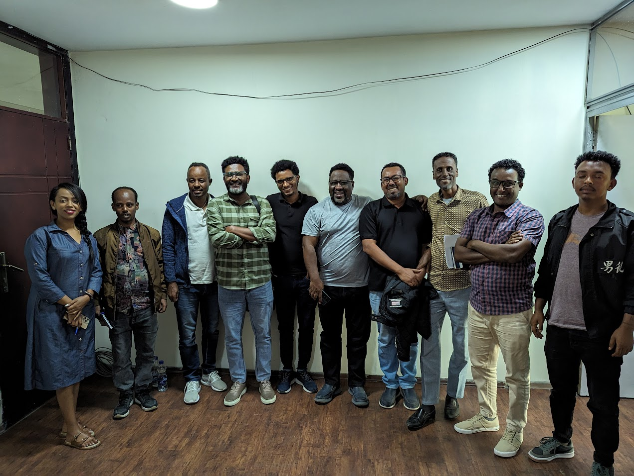
Our Story- Bethel and Mine
Serving Christ before Knowing Him- the story of a devout Orthodox Christian
Reading the Bible “ruined” everything
Excommunication and calling- the formation of Bethel Church
Leaving Bethel and Ethiopia, Settling in Central Ohio
The first Indigenous group in the north

Slide 6
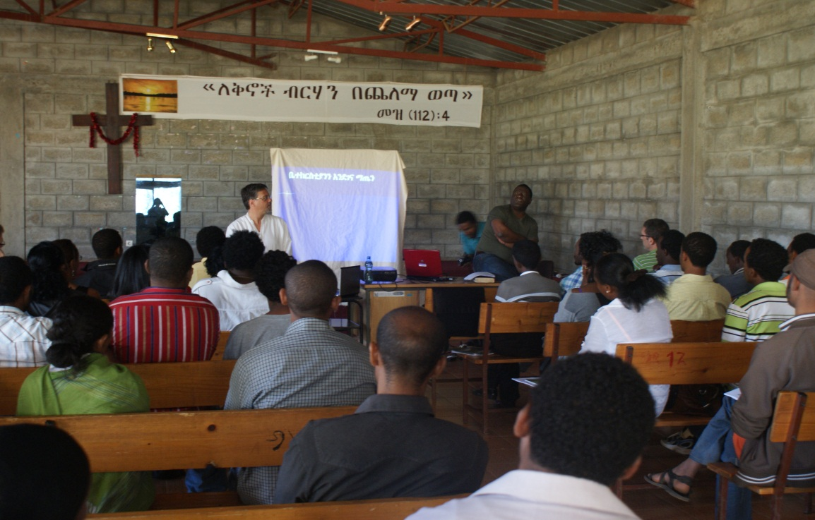
God’s Providence
The burden and the first Visit to Ethiopia
Dwell and Home church- His Faithfulness and Amazing Discovery
Getting acquainted with HC planting and developing the vision- more than two years of study

Slide 7
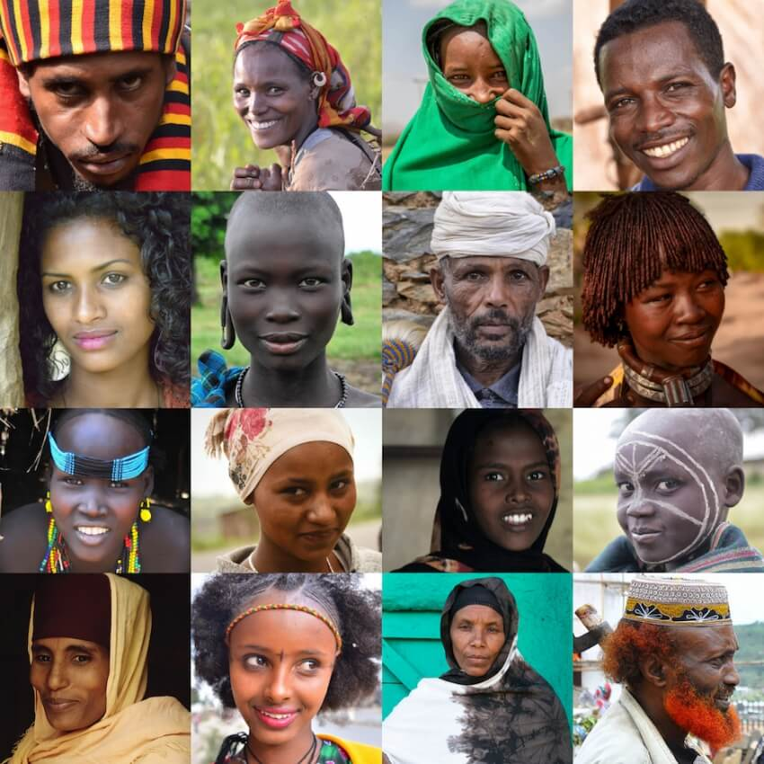
The Vision
To mobilize, equip, and plant a network of multiplying home churches throughout the Amhara and Tigray regions of northern Ethiopia with the goal of removing these people groups from the list of the unreached.

Slide 8
The Last 11 Years
Started with on-the-ground prayer and strategy
Developed training materials
Evangelism
Discipleship
Leadership
Vision sharing
Intense training
Local organization

Slide 9
The Last 11 Years
Started with on-the-ground prayer and strategy
Developed training materials
Evangelism
Discipleship
Leadership
Vision sharing
Intense training
Local organization

Slide 10
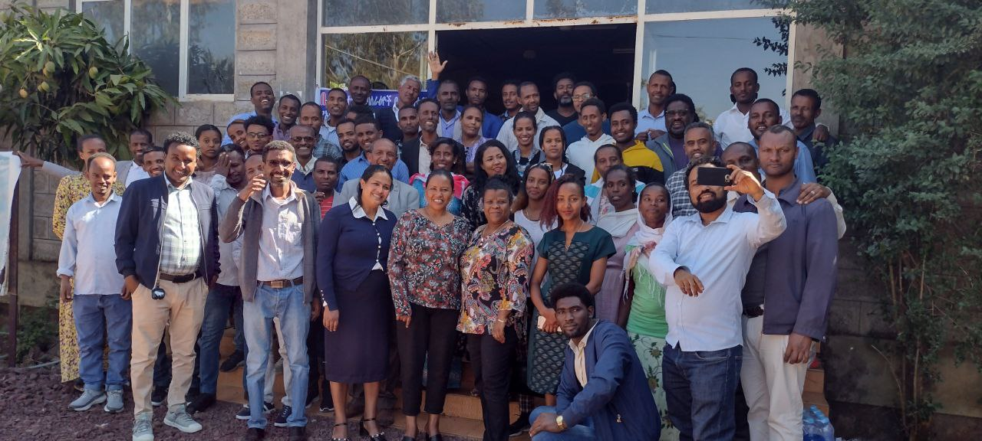
The Last 11 Years
Started with on-the-ground prayer and strategy
Developed training materials
Evangelism
Discipleship
Leadership
Vision sharing
Intense training
Local organization

Slide 11
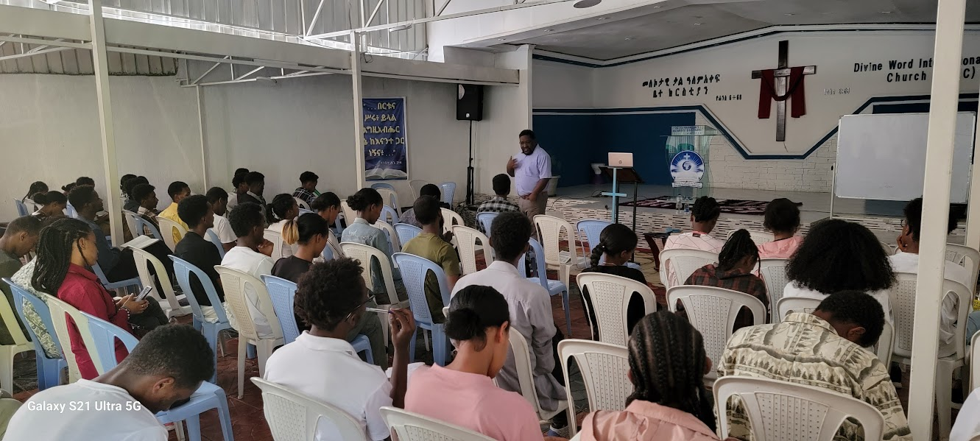
The Last 11 Years
Started with on-the-ground prayer and strategy
Developed training materials
Evangelism
Discipleship
Leadership
Vision sharing
Intense training
Local organization

Slide 12
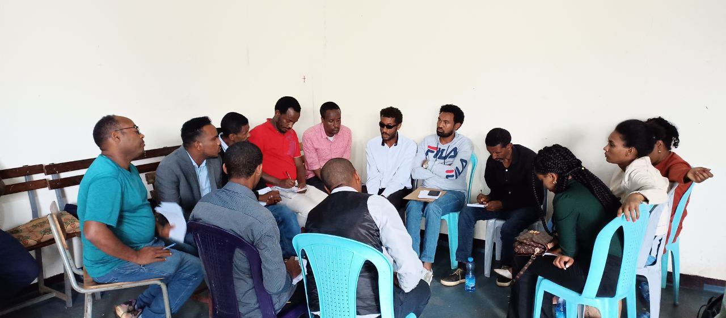
The Last 11 Years
Started with on-the-ground prayer and strategy
Developed training materials
Evangelism
Discipleship
Leadership
Vision sharing
Intense training
Local organization

Slide 13
The Last 11 Years
God has been at work in northern Ethiopia
House Churches from 2 to 52 Different Towns and Villages
From less than 200 to 3,400 believers
400 House Church Leaders Trained
181 House Churches
54 Church Planters
One School With More Than 300 Students
More than 4000 Presented With the Gospel Every Quarter

Slide 14
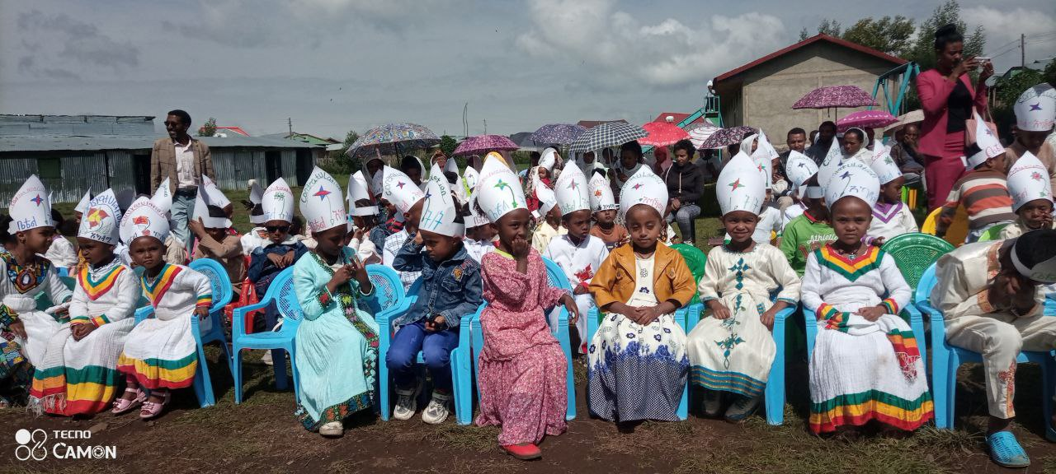
Injebara School
$10,000 Seed Money
Self-sustaining School for 5 Years
More Than 300 students

Slide 15
Challenges
The Orthodox Church
Four Years of Civil War and Conflict, Travel Restrictions
Humanitarian Crisis and Displacement

Slide 16
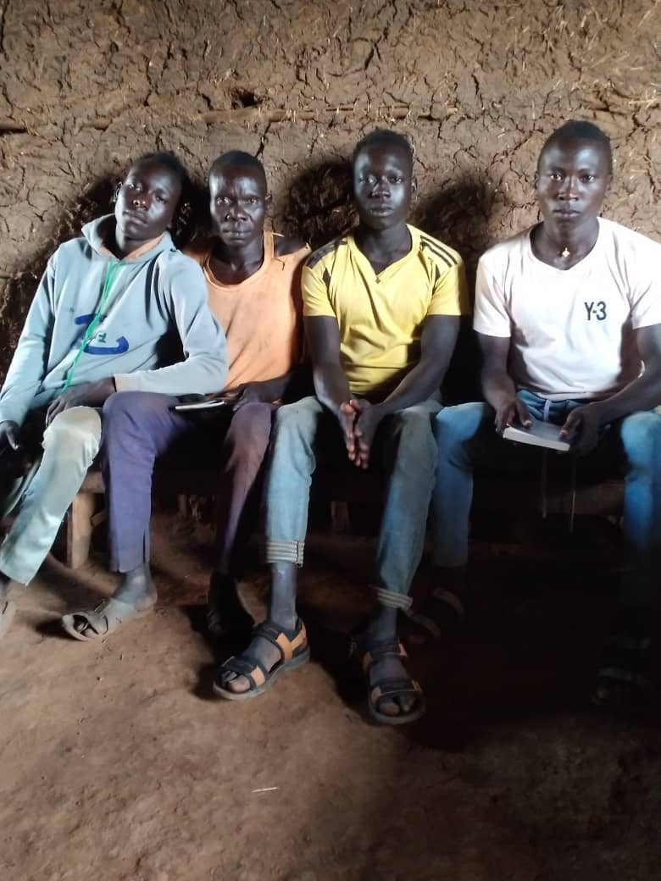
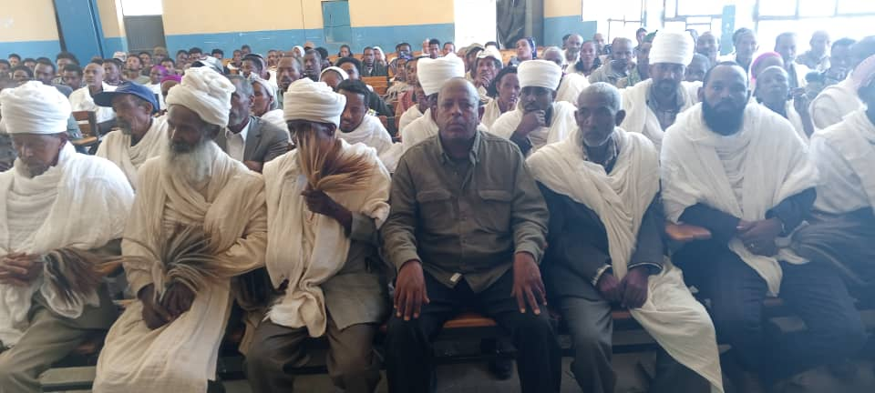
New Frontiers - Tigray and BG
Ethiopian Jews have been reached
Irob People are Coming to Christ
Churches in Several Villages in BG

Slide 17
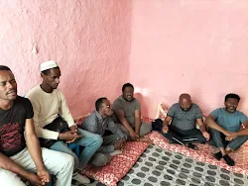
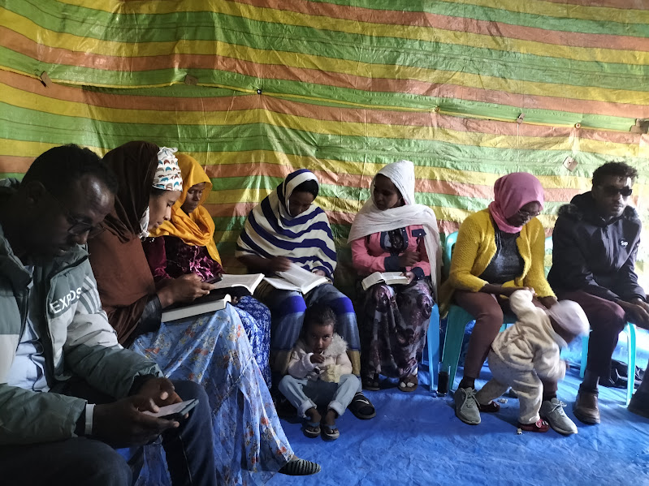
Wollo Muslims Reached
4 House Churches
More than 100 Muslim Converts

Slide 18
Pray Requests
Peace in the Country and Stability in the Amhara Region
Workers and Believers’ Protection
Leadership Development in Tigray
Wisdom for the Church Planters & Trainers
Prayer and Financial Support
Deploy More Church Planters
Provide Effective Training

Slide 19
Pray Requests
All the church planters and trainers who are involved in the field
Prayer and Financial support at home to continue to send more church planters and to effective training

