Slide 3
(Rev. 3:14) To the angel of the church in Laodicea write:

Slide 8
Incredibly wealthy city.
e.g. banking, clothing manufacture, prized medical school.
Strabo, Geography 12.8.20; Pseudo-Aristotle, On Marvelous Things Heard 58; Galen, De Sanitate Tuenda 6.12
Big earthquake in AD 60.
“Laodicea arose from the ruins by the strength of her own resources, and with no help from us” (Tacitus, Annals 14.27.1).
By AD 79, a patron named Nicostratus financed building a sports stadium! (Hemer, p.194)
No palatable water supply.
Strabo, Geography 13.4.14

Slide 9
(Rev. 3:14) To the angel of the church in Laodicea write:
These are the words of the Amen, the faithful and true witness, the ruler of God’s creation.

Slide 10
(Rev. 3:15) I know your deeds,
that you are neither cold nor hot.
I wish you were either one or the other!
¹⁶ So, because you are lukewarm (neither hot nor cold),
I am about to spit you out of my mouth.
???
What is cold, hot, and lukewarm?
Cold = “cold hearted toward God.”
Hot = “on fire for God!”
Lukewarm = “pew sitter” or “nominal Christian.”

Slide 12
Hierapolis had volcanic, medicinal hot springs.
Colin J. Hemer, The Letters to the Seven Churches of Asia in their Local Setting (England: Sheffield Academic Press, 1989), 182.

Slide 13
Hierapolis had volcanic, medicinal hot springs.
Colin J. Hemer, The Letters to the Seven Churches of Asia in their Local Setting (England: Sheffield Academic Press, 1989), 182.
Colossae had cold springs.
Colin J. Hemer, The Letters to the Seven Churches of Asia in their Local Setting (England: Sheffield Academic Press, 1989), 188.

Slide 14
(Rev. 3:15) I know your deeds,
that you are neither cold nor hot.
I wish you were either one or the other!
¹⁶ So, because you are lukewarm (neither hot nor cold),
I am about to spit you out of my mouth.
What is cold, hot, and lukewarm?
Cold is good.
Hot is good.
Lukewarm?

Slide 15
(Rev. 3:15) I know your deeds,
that you are neither cold nor hot.
I wish you were either one or the other!
¹⁶ So, because you are lukewarm (neither hot nor cold),
I am about to spit you out of my mouth.
What were they doing that was so bad??
Emperor worship?
Reverting to polytheism and idolatry?
Wild sinful living?

Slide 16
(Rev. 3:17) You say, ‘I am rich. I have acquired wealth and do not need a thing.’
The worst church addressed by Jesus wasn’t suffering from persecution,
but from prosperity!

Slide 17
(Rev. 3:17) You say, ‘I am rich. I have acquired wealth and do not need a thing.’
But you do not realize that you are wretched, pitiful, poor, blind and naked.

Slide 20
Meta-analysis of 175 studies using 258 distinct samples and 749 associations between materialism and personal wellbeing.

Slide 21
Meta-analysis of 175 studies using 258 distinct samples and 749 associations between materialism and personal wellbeing.

Slide 25
Top Four Environmental Problems for Youth?
(1) Poverty.
(2) Trauma.
(3) Discrimination.
(4) Excessive pressure to excel.
“Adolescent Wellness: Current Perspectives and Future Opportunities in Research, Policy, and Practice.” Robert Wood Johnson Foundation (2018), p.20.

Slide 26
“People who prioritize materialistic values and goals have lower-quality romantic and friend relationships.”
Kasser, T. (2018). Materialism and living well. In E. Diener (ed.) Handbook of Well-Being Salt Lake City, UT: DEF Publishers, 865.

Slide 27
“Marriage duration is inversely associated with spending on
the engagement ring
and wedding ceremony.”
Francis-Tan, et al. (2014). ‘A Diamond is Forever’ and Other Fairy Tales: The Relationship between Wedding Expenses and Marriage Duration (September 15, 2014).

Slide 28
“[There is a] negative association with marital quality,
even when spouses were unified in their materialistic values.”
Jason S. Carroll, et al., (2011). Materialism and marriage: Couple profiles of congruent and incongruent spouses. Journal of Couple and Relationship Therapy. 10, 287-308. (Studied 1,734)

Slide 29
What’s the solution?
“[There is a] negative association with marital quality,
even when spouses were unified in their materialistic values.”
Jason S. Carroll, et al., (2011). Materialism and marriage: Couple profiles of congruent and incongruent spouses. Journal of Couple and Relationship Therapy. 10, 287-308. (Studied 1,734)

Slide 30
(Rev. 3:18) So I advise you to buy gold from me—gold that has been purified by fire. Then you will be rich.
Also buy white garments from me so you will not be shamed by your nakedness,
and ointment for your eyes so you will be able to see.

Slide 31
(Rev. 3:18) So I advise you to buy gold from me—gold that has been purified by fire. Then you will be rich.
Also buy white garments from me so you will not be shamed by your nakedness,
and ointment for your eyes so you will be able to see.
#1. Invest where it matters: eternity
Give financially and live simply.
Aknin et al. (2013). Prosocial spending and well-being. Journal of Personality and Social Psychology, 104 (4), 635-652.

Slide 34
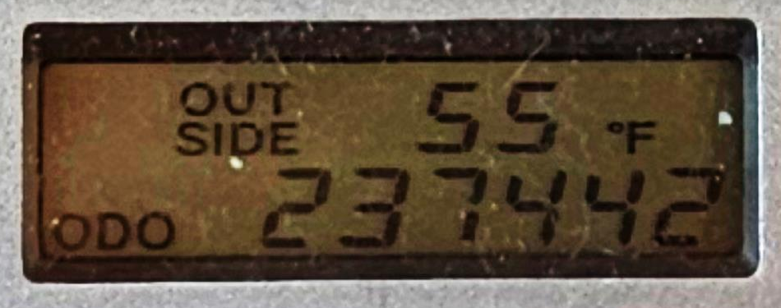

Slide 37
(Rev. 3:18) So I advise you to buy gold from me—gold that has been purified by fire. Then you will be rich.
Also buy white garments from me so you will not be shamed by your nakedness,
and ointment for your eyes so you will be able to see.
#1. Invest where it matters: eternity
Give financially and live simply.
Aknin et al. (2013). Prosocial spending and well-being. Journal of Personality and Social Psychology, 104 (4), 635-652.

Slide 38
(Rev. 3:19) Those whom I love I rebuke and discipline.
#2. Ask for input and accept correction
How do you know that you’re not currently being deceived on this issue?
“You do not realize that you are wretched, pitiful, poor, blind and naked” (v.17).
Are you feeling tension and struggle over financial decisions?

Slide 39
(Rev. 3:19) Those whom I love I rebuke and discipline.
So be earnest and repent.
#3. Seek Repentance
An unqualified, heartfelt admission of turning from God.
Turning back to God for
hope and strengthening.
What’s one step you need to take tonight?

Slide 40
(Rev. 3:20) Here I am! I stand at the door and knock.
If anyone hears my voice and opens the door, I will come in and eat with that person, and they with me.
#4. Let Christ into your life!
Do you need to grow your relationship with God?
Stop seeking happiness and value from your spending.
Seek happiness from the relational and spiritual side of life.
Do you need to start a relationship with God?

