Slide 1
Xsi
DEVELOPING RISK-TAKERS
2023

Slide 2
Mark 2:1-12
A few days later, when Jesus again entered Capernaum, the people heard that he had come home. They gathered in such large numbers that there was no room left, not even outside the door, and he preached the word to them.
Some men came, bringing to him a paralyzed man, carried by four of them. Since they could not get him to Jesus because of the crowd, they made an opening in the roof above Jesus by digging through it and then lowered the mat the man was lying on.

Slide 3
Mark 2:1-12
When Jesus saw their faith, he said to the paralyzed man, “Son, your sins are forgiven.” Now some teachers of the law were sitting there, thinking to themselves, “Why does this fellow talk like that? He’s blaspheming! Who can forgive sins but God alone?”
Immediately Jesus knew in his spirit that this was what they were thinking in their hearts, and he said to them, “Why are you thinking these things? Which is easier: to say to this paralyzed man, ‘Your sins are forgiven,’ or to say, ‘Get up, take your mat and walk’?...

Slide 4
Mark 2:1-12
“But I want you to know that the Son of Man has authority on earth to forgive sins.”
So he said to the man, “I tell you, get up, take your mat and go home.” He got up, took his mat and walked out in full view of them all. This amazed everyone and they praised God, saying, “We have never seen anything like this!”

Slide 5
Mark 5:24-27
A large crowd followed and pressed around him. And a woman was there who had been subject to bleeding for twelve years. She had suffered a great deal under the care of many doctors and had spent all she had, yet instead of getting better she grew worse.
When she heard about Jesus, she came up behind him in the crowd and touched his cloak, because she thought, “If I just touch his clothes, I will be healed.” Immediately her bleeding stopped and she felt in her body that she was freed from her suffering.

Slide 6
Mark 5:30-34
At once Jesus realized that power had gone out from him. He turned around in the crowd and asked, “Who touched my clothes?”…
Jesus kept looking around to see who had done it. Then the woman, knowing what had happened to her, came and fell at his feet and, trembling with fear, told him the whole truth. He said to her, “Daughter, your faith has healed you. Go in peace and be freed from your suffering.”

Slide 7
KEY POINT
In the New Testament, Jesus often identified faith in those who took risks.
And the faith of his followers often manifested in risk-taking.

Slide 8
OTHER EXAMPLES
The Magi dodging Herod
Mary & Joseph fleeing to Egypt
Simon leaving small business
Levi leaving tax booth
Disciples healing at the Temple
Lepers approaching Jesus
Nicodemus seeking Jesus
John rebuking the Pharisees
Paul doing basically anything
Centurion seeking help
The blind man’s testimony
The woman anointing Jesus

Slide 9
1
Unmask the illusion of security
Not concerned about all details
Resist controlling everything
Don’t wait for guarantees
Risk-takers embrace uncertainty.

Slide 10
Action steps? Thoughts? Observations? Experiences?
1
Dive headfirst into pagan world
Random assignments
Openly discuss the un-knowables and things outside control
Reflect on personal testimony and how God worked behind scenes
Risk-takers embrace uncertainty.

Slide 11
God has a work that He desires to do, and God is simply looking for people who are in harmony with what He desires in order that He might show Himself strong on their behalf. The key is to discover what it is that God wants to do.
I've found that the best way is by just stepping out. Try it and see. Maybe God will work. Maybe God is wanting to work. Let's give Him a chance. But again, always have the attitude “If it doesn't work, let's not push it.”
Maintain that flexibility of being able to walk away from a project. If it's obvious that it isn't working, then let's not push it and try and make it work.
CHUCK SMITH | VENTURES IN FAITH

Slide 12
Timid people only look at what might happen if they step out
What about not doing anything?
2
Matthew 25:28-29 “‘So take the bag of gold from him and give it to the one who has ten bags. For whoever has will be given more, and they will have an abundance. Whoever does not have, even what they have will be taken from them.’”
Risk-takers assess the danger of fear & inaction.

Slide 13
Action steps? Thoughts? Observations? Experiences?
2
Brainstorm, stew, obsess about what could go right
Study longtime losses among your friends and family (perils of not doing anything)
Read on materialism, comfort, isolation, loneliness
Risk-takers assess the danger of fear & inaction.

Slide 14
3
Learn from their own failure and vicariously through others
Willing to try new things
Develop tougher skin
Deepen their identity in Jesus
Risk-takers learn through failure.

Slide 15
Action steps? Thoughts? Observations? Experiences?
3
Tell stories of past efforts that worked and didn’t
Be open about lessons learned
Avoid focusing too much on feelings
Diagnose problems, solutions
Risk-takers learn through failure.

Slide 16
Don’t expect hand-outs
Enjoy hard work
Patient
Resist helplessness
Grow in creativity
Don’t wait to be hounded
Never bored
4
Risk-takers fight entitlement.

Slide 17
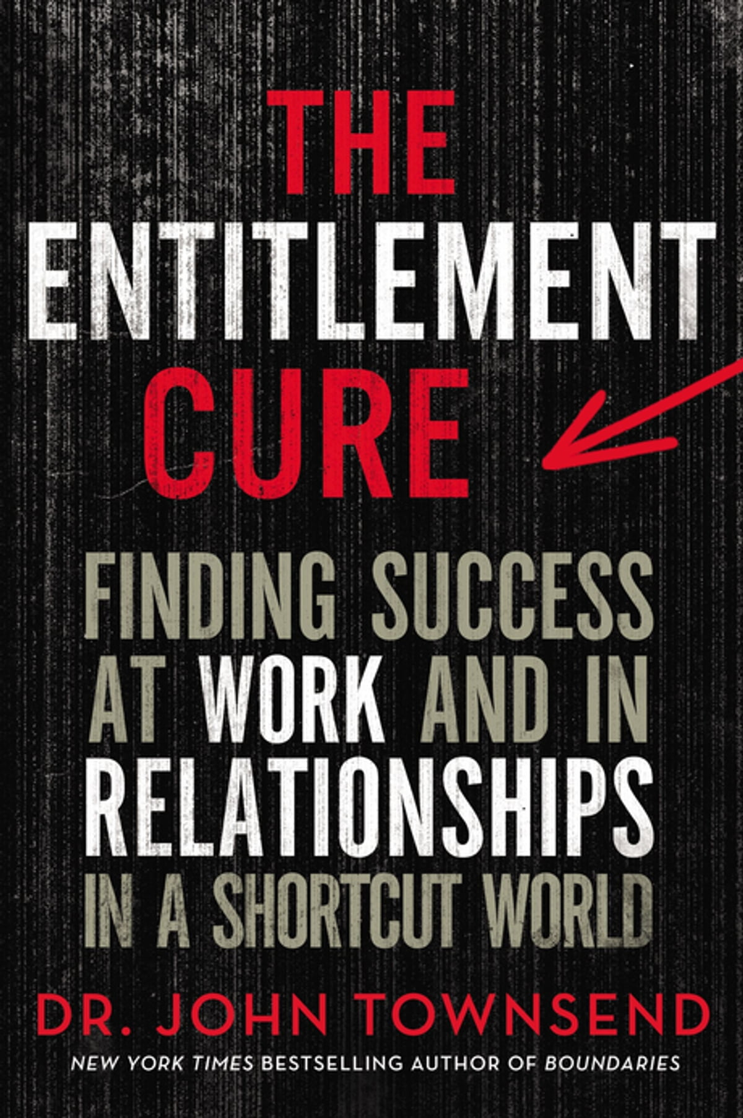
Consider just a few of the many benefits risk has for you:
Risk is your only hope for “better” in anything. Without risk, your only path is “the same,” whether in your career, love life, or some passion such as a hobby or ministry. Without risk, you are certain to do no better than the “same,” if not worse. Do you really want such a path?

Slide 18
Consider just a few of the many benefits risk has for you:
The process of risk brings out the best in you. It forces you to think, plan, obsess, look at the facts, make judgments, and set priorities. You can’t be lazy and risky at the same time.

Slide 19
Consider just a few of the many benefits risk has for you:
Risk humbles you because it takes you to the limit of yourself. When you get on the phone to pitch that next sale, you don’t know what will happen and you can’t control it. You could fail, and you wouldn’t like that.

Slide 20
Action steps? Thoughts? Observations? Experiences?
4
Vocalize expectations
Deepen thankfulness
Understand obedience from a biblical perspective
Risk-takers fight entitlement.

Slide 21
Action steps? Thoughts? Observations? Experiences?
4
2 Corinthians 4:1 Therefore, since through God’s mercy we have this ministry, we do not lose heart.
Risk-takers fight entitlement.
2 Corinthians 4:7-9 But we have this treasure in jars of clay to show that this all-surpassing power is from God and not from us. We are hard pressed on every side, but not crushed; perplexed, but not in despair; persecuted, but not abandoned; struck down, but not destroyed.

Slide 22
DEVELOPING RISK-TAKERS
1
2
3
4
Risk-takers embrace uncertainty.
Risk-takers assess the danger of fear & inaction.
Risk-takers learn through failure.
Risk-takers fight entitlement.
rossj@dwellcc.org

