Slide 1
“I will build My church” -Jesus (Matthew 16:18)
Servant Team, 2024

Slide 2
Matthew 16:
“13 Now when Jesus came into the district of Caesarea Philippi, He asked His disciples, ‘Who do people say that the Son of Man is?’ 14 And they said, ‘Some say John the Baptist, others say Elijah, and others Jeremiah or one of the prophets.’ 15 He said to them, ‘But who you do say that I am?’

Slide 3
Matthew 16:
“16 Simon Peter replied, ‘You are the Christ, the Son of the living God.’ 17 And Jesus answered him, ‘Blessed are you, Simon Bar-Jonah! For flesh and blood has not revealed this to you, but My Father who is in heaven. 18 And I tell you, you are Peter, and on this rock I will build My church, and the gates of hell shall not prevail against it.’”

Slide 4
Matthew 16:
“16 Simon Peter replied, ‘You are the Christ, the Son of the living God.’ 17 And Jesus answered him, ‘Blessed are you, Simon Bar-Jonah! For flesh and blood has not revealed this to you, but My Father who is in heaven. 18 And I tell you, you are Peter, and on this rock I will build My church, and the gates of hell shall not prevail against it.’”
Notes:
-vertical perspective; can’t have growth without faith
-Heb 11:6 – without faith it is impossible to please God

Slide 5
Matthew 16:
“16 Simon Peter replied, ‘You are the Christ, the Son of the living God.’ 17 And Jesus answered him, ‘Blessed are you, Simon Bar-Jonah! For flesh and blood has not revealed this to you, but My Father who is in heaven. 18 And I tell you, you are Peter, and on this rock I will build My church, and the gates of hell shall not prevail against it.’”

Slide 6
Matthew 16:
“16 Simon Peter replied, ‘You are the Christ, the Son of the living God.’ 17 And Jesus answered him, ‘Blessed are you, Simon Bar-Jonah! For flesh and blood has not revealed this to you, but My Father who is in heaven. 18 And I tell you, you are Peter, and on this rock I will build My church, and the gates of hell shall not prevail against it.’”
Notes:
-need to get our “why” directly from God

Slide 7
Matthew 16:
“16 Simon Peter replied, ‘You are the Christ, the Son of the living God.’ 17 And Jesus answered him, ‘Blessed are you, Simon Bar-Jonah! For flesh and blood has not revealed this to you, but My Father who is in heaven. 18 And I tell you, you are Peter, and on this rock I will build My church, and the gates of hell shall not prevail against it.’”

Slide 8
Matthew 16:
Matthew 7:24 – “Therefore everyone who hears these words of Mine and acts on them, may be compared to a wise man who built his house on the rock.”
1 Corinthians 3:11 – “For no man can lay a foundation other than the one which is laid, which is Jesus Christ.”
“16 Simon Peter replied, ‘You are the Christ, the Son of the living God.’ 17 And Jesus answered him, ‘Blessed are you, Simon Bar-Jonah! For flesh and blood has not revealed this to you, but My Father who is in heaven. 18 And I tell you, you are Peter, and on this rock I will build My church, and the gates of hell shall not prevail against it.’”

Slide 9
Matthew 16:
“16 Simon Peter replied, ‘You are the Christ, the Son of the living God.’ 17 And Jesus answered him, ‘Blessed are you, Simon Bar-Jonah! For flesh and blood has not revealed this to you, but My Father who is in heaven. 18 And I tell you, you are Peter, and on this rock I will build My church, and the gates of hell shall not prevail against it.’”
Notes:
-not a question of IF, only how

Slide 10
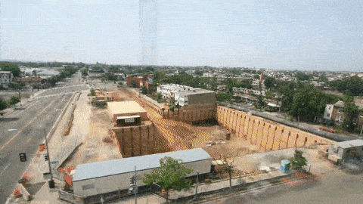
Matthew 16:
“16 Simon Peter replied, ‘You are the Christ, the Son of the living God.’ 17 And Jesus answered him, ‘Blessed are you, Simon Bar-Jonah! For flesh and blood has not revealed this to you, but My Father who is in heaven. 18 And I tell you, you are Peter, and on this rock I will build My church, and the gates of hell shall not prevail against it.’”
Notes:
-we should talk about church growth, pray for it & expect it
-we shouldn’t turn against the idea of church growth & we also shouldn’t worry about it so much

Slide 11
Matthew 16:
“16 Simon Peter replied, ‘You are the Christ, the Son of the living God.’ 17 And Jesus answered him, ‘Blessed are you, Simon Bar-Jonah! For flesh and blood has not revealed this to you, but My Father who is in heaven. 18 And I tell you, you are Peter, and on this rock I will build My church, and the gates of hell shall not prevail against it.’”
Notes:
-should we be surprised at Satanic opposition? no. will this opposition prevail against God growing His church? certainly not.

Slide 12
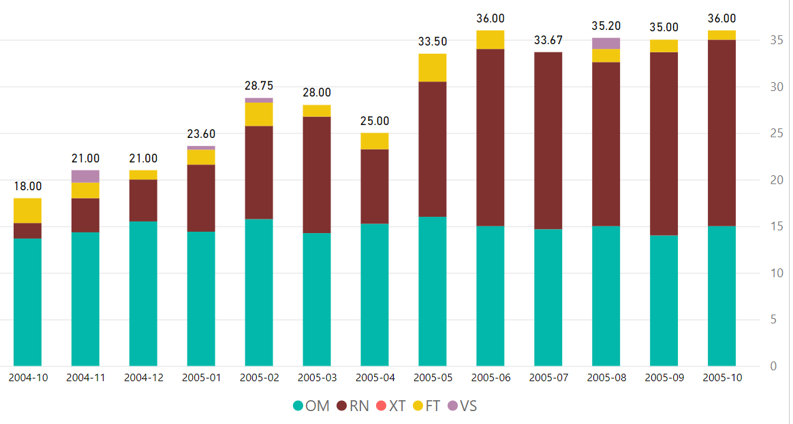
-Diesel V

Slide 13
Edward Kimball

Slide 14
Billy Graham
Notes:
-led 3.2 million people to Christ
-lifetime audience topped 2.2 billion

Slide 15
??
Edward Kimball
??
??
??
??
??
??
??
Dwight Moody
F.B. Meyer
J. Wilbur Chapman
Billy Sunday
Mordecai Ham
Billy Graham

Slide 16
Pepsi Presents HC
Adamantium
Nov 2008

Slide 17
Pepsi Presents HC
Easy Co
Adamantium
Nov 2008
Adamantium 2

Slide 18
Pepsi Presents HC
Easy Co 2
Easy Co
Adamantium
Nov 2008
United
Adamantium 2
Adamantium 3

Slide 19
Pepsi Presents HC
Easy Co 2
Easy Co 3
Easy Co
Adamantium
Nov 2008
Rebel Alliance
United
Adamantium 2
Adamantium 3
United 2
Adamantium 4

Slide 20
Pepsi Presents HC
Easy Co 2
Easy Co 3
Easy Co
Adamantium
Nov 2008
Rebel Alliance
United
Adamantium 2
Adamantium 3
United 2
Adamantium 4
Imperial
United 3
Adamantium 5

Slide 21
Pepsi Presents HC
Easy Co 2
Easy Co 3
Easy Co
Adamantium
Easy Co 4
Nov 2008
Rebel Alliance
United
Adamantium 2
Adamantium 3
United 2
Rebel 2
Adamantium 4
Pacific
Imperial
United 3
Adamantium 5

Slide 22
Pepsi Presents HC
Easy Co 2
Easy Co 3
Easy Co
Adamantium
Easy Co 4
Nov 2008
Rebel Alliance
United
Adamantium 2
Easy Co 5
Adamantium 3
United 2
Rebel 2
Adamantium 4
Pacific
Imperial
United 3
Adamantium 5
Comanche plant with Diesel

Slide 23
Pepsi Presents HC
Easy Co 2
Easy Co 3
Easy Co
Adamantium
Easy Co 4
Nov 2008
Rebel Alliance
United
Adamantium 2
Easy Co 5
Adamantium 3
United 2
Rebel 2
Easy Co 6
Adamantium 4
Pacific
Imperial
United 3
Adamantium 5
Bastogne plant with Diesel

Slide 24
Pepsi Presents HC
Easy Co 2
Easy Co 3
Easy Co
Adamantium
Easy Co 4
Nov 2008
Rebel Alliance
United
Adamantium 2
Easy Co 5
Adamantium 3
United 2
Rebel 2
Easy Co 6
Adamantium 4
Pacific
Imperial
United 3
Adamantium 5
Adamantium 6
Hyperion

Slide 25
Pepsi Presents HC
Easy Co 2
Easy Co 3
Easy Co
Adamantium
Easy Co 4
Nov 2008
Rebel Alliance
United
Adamantium 2
Easy Co 5
Adamantium 3
United 2
Rebel 2
Easy Co 6
Adamantium 4
Pacific
Imperial
United 3
Adamantium 5
Beretta
Adamantium 6
Hyperion
United 4
Pacific 2

Slide 26
Pepsi Presents HC
Easy Co 2
Easy Co 3
Easy Co
Adamantium
Easy Co 4
Nov 2008
Rebel Alliance
United
Adamantium 2
Easy Co 5
Adamantium 3
United 2
Rebel 2
Easy Co 6
Adamantium 4
Rebel 3
Pacific
Imperial
United 3
Adamantium 5
Beretta
Adamantium 6
Providence
Hyperion
United 4
Adamantium 7
Pacific 2

Slide 27
Pepsi Presents HC
Easy Co 2
Easy Co 3
Easy Co
Adamantium
Easy Co 4
Nov 2008
Rebel Alliance
United
Adamantium 2
Easy Co 5
Adamantium 3
United 2
Rebel 2
Easy Co 6
Adamantium 4
Rebel 3
Pacific
Imperial
United 3
Adamantium 5
Beretta
Adamantium 6
Providence
Hyperion
United 4
Adamantium 7
Rogue
Imperial 2
Beretta 2
United 5
Pacific 2

Slide 28
Pepsi Presents HC
Easy Co 2
Easy Co 3
Easy Co
Adamantium
Easy Co 4
Nov 2008
Rebel Alliance
United
Adamantium 2
Easy Co 5
Adamantium 3
United 2
Rebel 2
Easy Co 6
Adamantium 4
Rebel 3
Pacific
Imperial
United 3
Adamantium 5
Rebel 4
Beretta
Adamantium 6
Providence
Breckenridge
Hyperion
United 4
Adamantium 7
Rogue
Imperial 2
Beretta 2
Hyperion 2
Providence 2
United 5
Pacific 2

Slide 29
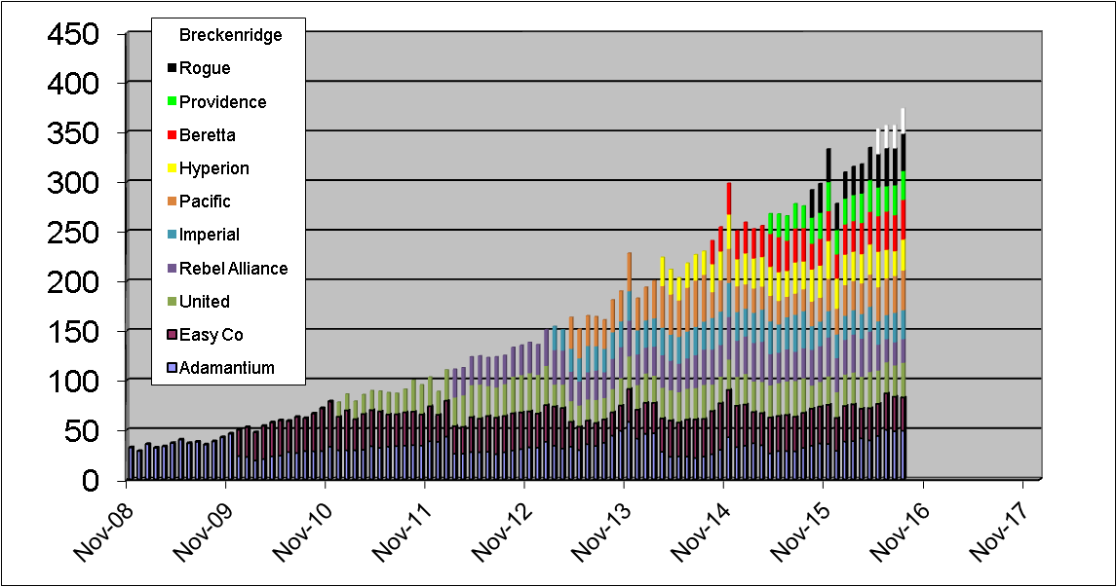
Bastogne plant with Diesel
Comanche plant with Diesel
Started with around 30
About 12.5x growth in 8 years; 8 more years at this rate would equal 4687 people

Slide 30
Dixon HC
Globo-Chem
July 2004

Slide 31
Dixon HC
Chupacabra
Globo-Chem
July 2004
Globo-Chem 2

Slide 32
Dixon HC
Chupacabra
Chupacabra 2
Globo-Chem
July 2004
Guerrilla
Globo-Chem 2
Globo-Chem 3

Slide 33
Dixon HC
Chupacabra
Chupacabra 2
Globo-Chem
July 2004
Guerrilla
Globo-Chem 2
Viacaom
Globo-Chem 3
Globo-Chem 4

Slide 34
Dixon HC
Chupacabra
Chupacabra 2
Chupa 3
Yeti
Globo-Chem
July 2004
Guerrilla
Globo-Chem 2
Viacaom
Globo-Chem 3
Globo-Chem 4

Slide 35
Dixon HC
Chupacabra 2
Chupa 3
Chupa 4
Chupacabra
Yeti
Globo-Chem
July 2004
Guerrilla
Globo-Chem 2
Viacaom
Globo-Chem 3
Eisenhower plant with Roosevelt
Globo-Chem 4

Slide 36
Dixon HC
Chupacabra 2
Chupa 3
Chupa 4
Chupacabra
Yeti
Globo-Chem
July 2004
Guerrilla
Guerrilla 2
Globo-Chem 2
Viacaom
Thundera
Globo-Chem 3
Moonbase
Globo-Chem 4
Globo-Chem 5

Slide 37
Dixon HC
Chupacabra 2
Chupa 3
Chupa 4
Chupacabra
Yeti
Globo-Chem
July 2004
Guerrilla
Guerrilla 2
Globo-Chem 2
Viacaom
Thundera
Globo-Chem 3
Moonbase
Moonbase 2
Globo-Chem 4
Globo-Chem 5
Zeppelin
Globo-Chem 6

Slide 38
Dixon HC
Chupacabra 2
Chupa 3
Chupa 4
Chupacabra
Yeti
Globo-Chem
July 2004
Guerrilla
Guerrilla 2
Globo-Chem 2
Viacaom
Thundera
Globo-Chem 3
Moonbase
Moonbase 2
Globo-Chem 4
Globo-Chem 5
Zeppelin
Globo-Chem 6
Colossus
Globo-Chem 7

Slide 39
Dixon HC
Chupacabra 2
Chupa 3
Chupa 4
Chupacabra
Yeti
Globo-Chem
July 2004
Guerrilla
Guerrilla 2
Globo-Chem 2
Viacaom
Thundera
Globo-Chem 3
Moonbase
Moonbase 2
Globo-Chem 4
Globo-Chem 5
Zeppelin
Zeppelin 2
Globo-Chem 6
Colossus
Globo-Chem 7
Tomahawk
Globo-Chem 8

Slide 40
Dixon HC
Chupacabra 2
Chupa 3
Chupa 4
Chupacabra
Yeti
Globo-Chem
July 2004
Guerrilla
Guerrilla 2
Globo-Chem 2
Viacaom
Thundera
Globo-Chem 3
Moonbase
Moonbase 2
Globo-Chem 4
Globo-Chem 5
Zeppelin
Zeppelin 2
Globo-Chem 6
Colossus
Tomahawk 2
Globo-Chem 7
Tomahawk
Globo-Chem 8
Globo-Chem 9
Citadel

Slide 41
Dixon HC
Chupacabra 2
Chupa 3
Chupa 4
Chupacabra
Yeti
Globo-Chem
July 2004
Guerrilla
Guerrilla 2
Globo-Chem 2
Viacaom
Thundera
Globo-Chem 3
Moonbase
Moonbase 2
Globo-Chem 4
Zeppelin 3
Globo-Chem 5
Zeppelin
Zeppelin 2
Colossus 2
Globo-Chem 6
Colossus
Tomahawk 2
Globo-Chem 7
Tomahawk
Jurassic
Globo-Chem 8
Globo-Chem 9
Citadel

Slide 42
Dixon HC
Chupacabra 2
Chupa 3
Chupa 4
Chupacabra
Yeti
Globo-Chem
July 2004
Guerrilla
Guerrilla 2
Globo-Chem 2
Viacaom
Thundera
Globo-Chem 3
Moonbase
Moonbase 2
Moonbase 3
Globo-Chem 4
Zeppelin 3
Globo-Chem 5
Zeppelin
Zeppelin 2
Colossus 2
Globo-Chem 6
Colossus
Tomahawk 2
Globo-Chem 7
Tomahawk
Jurassic
Jurassic 2
Globo-Chem 8
Globo-Chem 9
Globo-Chem 10
Citadel
Everest

Slide 43
Dixon HC
Chupacabra 2
Chupa 3
Chupa 4
Chupacabra
Yeti
Globo-Chem
July 2004
Guerrilla
Guerrilla 2
Globo-Chem 2
Viacaom
Thundera
Globo-Chem 3
Moonbase
Moonbase 2
Moonbase 3
Globo-Chem 4
Started with under 25
Zeppelin 3
Globo-Chem 5
Zeppelin
Zeppelin 2
Colossus 2
Globo-Chem 6
Colossus
Tomahawk 2
Globo-Chem 7
Tomahawk
Jurassic
Jurassic 2
Globo-Chem 8
Globo-Chem 9
Globo-Chem 10
Citadel
Everest

Slide 44
Dixon HC
Chupacabra 2
Chupa 3
Chupa 4
Chupacabra
Yeti
Now up over 250 – this represents over 10x growth in 12 years, at this rate in another 12 years this would be more than 2500 HS students
Globo-Chem
July 2004
Guerrilla
Guerrilla 2
Globo-Chem 2
Viacaom
Thundera
Globo-Chem 3
Moonbase
Moonbase 2
Moonbase 3
Globo-Chem 4
Zeppelin 3
Globo-Chem 5
Zeppelin
Zeppelin 2
Colossus 2
Globo-Chem 6
Colossus
Tomahawk 2
Globo-Chem 7
Tomahawk
Jurassic
Jurassic 2
Globo-Chem 8
Globo-Chem 9
Globo-Chem 10
Citadel
Everest

Slide 46
2008-2018 – college/HS
-grew from 1100 to 2600
-sent 900 adult
-lost 3500
-experienced ~5800 salvations

Slide 49
2019-2023 – college/HS
-declined by about 1000
-sent 950 adult
-lost 1500
-sent 130 (mostly students) to domestic church plants
-experienced ~1500 salvations

Slide 50
Benefits of the slow down:
1. a lot of the premo leaders during that movement started having kids
2. able to spend longer & go deeper with our disciples on character
3. this has given us a greater love & value for slower movers

Slide 51
Benefits of the slow down:
4. God has used this to purify & solidify character of existing leaders
5. this has forced us to try to innovate & think outside of the box
6. our interest in foreign & domestic missions sending is improving

Slide 52
Final thoughts:
This story about the movement really focuses on student min, what about adult?
2 Timothy 4:1-2 – “I solemnly charge you in the presence of God and of Christ Jesus, who is to judge the living and the dead, and by His appearing and His kingdom: preach the word; be ready in season and out of season; reprove, rebuke, exhort, with great patience and instruction.”

Slide 53
Final thoughts:
This story about the movement really focuses on student min, what about adult?
Sooo…should we just wait for the next movement to happen? what about now?
Jesus says, “I will build My church and the gates of hell shall not prevail against it!”

