Slide 1
The Curious Discipler
Counseling Enhancement
Spring 2024

Slide 2
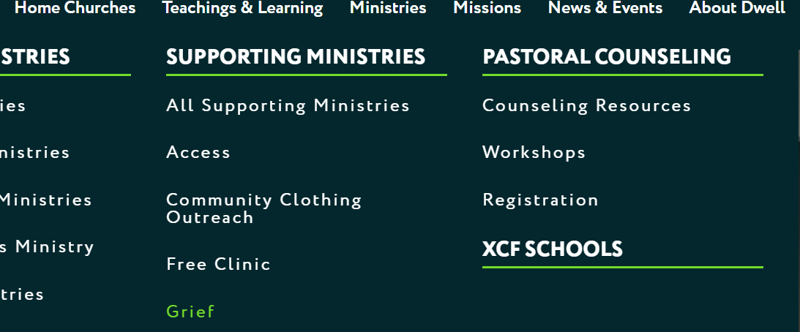
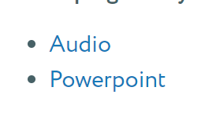

Slide 3
Goal of Discipleship
Dwell’s specific definition:
A discipler is one who helps willing people attain Servant Team status and the ability to replicate disciples by holding regular meetings for study, coaching, counseling, and prayer in the context of a close personal relationship.
Mature character
Ministry competence

Slide 4
Goal of Discipleship
We practice discipleship because we don’t want people to be:
Ignorant and lacking wisdom
Incompetent
Passive

Slide 5
Goal of Discipleship
Big picture:
Raise up competent ministers who are internally motivated
Help people learn how to think for themselves
We can’t provide all the motivation and thinking
That’s where questions play a key role

Slide 6
Using Good Questions
No false dichotomies:
Questions vs. teaching/exhortation
Empathy vs. correction/challenge
Listening vs. speaking

Slide 7
Using Good Questions
No false dichotomies:
Questions AND teaching/exhortation
Empathy AND correction/challenge
Listening AND speaking

Slide 8
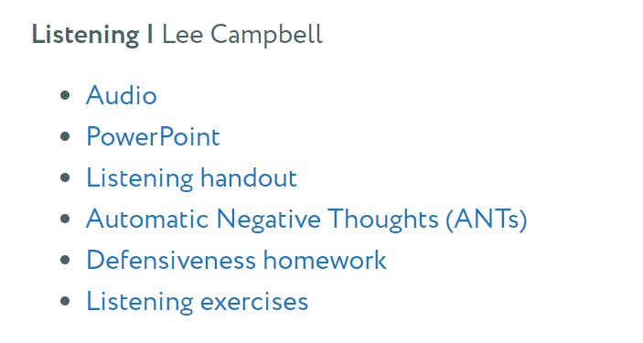
Using Good Questions
No false dichotomies:
Questions AND teaching/exhortation
Empathy AND correction/challenge
Listening AND speaking

Slide 9
Questions in the Bible
1 Kings 19:9 – And the word of the Lord came to him: “What are you doing here, Elijah?”
1 Kings 19:13 – Then a voice said to him: “What are you doing here, Elijah?”
Questions get people talking

Slide 10
Questions in the Bible
Matthew 16:13-15 – “He asked his disciples, ‘Who do people say the Son of Man is?’…
‘But what about you?’ he asked. ‘Who do you say I am?’
Questions get people thinking

Slide 11
Questions in the Bible
Genesis 3: 8b – they hid from the LORD God among the trees of the garden. 9 But the LORD God called to the man, “Where are you?”

Slide 12
Questions in the Bible
Genesis 3:10 He answered, “I heard you in the garden, and I was afraid because I was naked; so I hid.”
11 And he said, “Who told you that you were naked? Have you eaten from the tree that I commanded you not to eat from?”
Questions invite openness

Slide 13
Questions in the Bible
John 6:5 When Jesus looked up and saw a great crowd coming toward him, he said to Philip, “Where shall we buy bread for these people to eat?”
6 He asked this only to test him, for he already had in mind what he was going to do.
Questions draw people into the solution

Slide 14
Questions in the Bible
Matthew 20:32 to the 2 blind beggars: “What do you want me to do for you?”
Questions invite people to say what they want

Slide 15
Questions in the Bible
Matthew 20:21 (to Salome): “What is it you want?”
v22 (to James and John): “Can you drink the cup I am going to drink?”
Questions can be a gentle challenge

Slide 16
Questions in the Bible
So God uses questions for relational reasons:
To get us talking or thinking
To invite openness and honesty
To gently challenge
We have an additional reason:

Slide 17
When you are asking a good question, you are adopting a position of humility.
You’re confessing that you don’t know and you want to learn.
God asks questions for relational reasons – we have those same reasons AND our lack of omniscience

Slide 18
How good are you at reading people?
I probably don’t know you personally, but I can make the following statement with a high degree of confidence:
You’re not as good as you think you are.
Questions are a skill that can be learned
I know because I am not a natural

Slide 19
Reasons we don’t use questions
Efficiency

Slide 20
A good conversationalist controls her impatience and listens to learn, rather than to respond.
That means she’ll wait for the end of the other person’s comment, and then pause for a few beats to consider how to respond to what’s been said.

Slide 21
Reasons we don’t use questions
Efficiency
Anxiety
Too much noise in our own heads
Anxiety about our own effectiveness or about their struggles
“Tell-Sell-Yell” pattern

Slide 22
Reasons we don’t use questions
Efficiency
Anxiety
Effort
Subtle pride
I like helping and having the right answer
I have already decided what is going on

Slide 23
If you already have your own conceptions about people you will find it difficult to take in what they say because your mind is already full of your own conclusions.

Slide 24
Reasons we don’t use questions
Efficiency
Anxiety
Effort
Subtle pride
Lack of awareness (statements masquerading as questions)

Slide 25
The power of questions
“What color is your house?”
What did your brain just do?

Slide 26
Questions trigger a mental reflex known as “instinctive elaboration.” When a question is posed, it takes over the brain’s thought process.
And when your brain is thinking about the answer to a question, it can’t contemplate anything else.
https://www.fastcompany.com/3068341/want-to-know-what-your-brain-does-when-it-hears-a-question

Slide 27
The power of questions
1. Questions can disrupt our thoughts

Slide 28
When you ask a question instead of giving the answer, the entire brain gets active as it reflects, releasing serotonin (allowing it to relax).
This encourages gathering intelligence from all areas of the brain, allowing for more insight than would happen if you provided solutions to others.
New neuronal connections begin to be made as the brain moves closer to finding solutions.
https://www.govexec.com/management/2017/04/neuroscience-asking-insightful-questions/137274/#:~:text=Reflection%3A%20When%20you%20ask%20a,you%20provided%20solutions%20to%20others

Slide 29
The power of questions
Questions can disrupt our thoughts
Questions can calm and activate our minds

Slide 30
Behavioral scientists have also found that just asking people about their future decisions significantly influences those decisions, a phenomenon known as the “mere measurement effect.”
According to a study published in the Journal of Applied Psychology, asking citizens whether they’re going to vote in an upcoming election increases the likelihood that they will by 25%.
https://www.fastcompany.com/3068341/want-to-know-what-your-brain-does-when-it-hears-a-question

Slide 31
The power of questions
Questions can disrupt our thoughts
Questions can calm and activate our minds
Questions can influence our actions

Slide 32
You are also honoring a person.
We all like to think we are so clever that we can imagine what’s going on in another’s mind. But the evidence shows that this doesn’t work.
People are just too different from one another, too complicated, too idiosyncratic.

Slide 33
The power of questions
Questions can disrupt our thoughts
Questions can calm and activate our minds
Questions can influence our actions
Questions communicate respect
Questions keep people talking

Slide 34
General Questions We Can Ask
“Well, what do you think?”
Proverbs 20:5 – Though good advice lies deep within the heart, a person of understanding will draw it out.

Slide 35
General Questions We Can Ask
“Well, what do you think?”
“What do you mean by that?”

Slide 36
General Questions We Can Ask
“Well, what do you think?”
“What do you mean by that?”
“What’s the next step?”
“What have you tried so far?”
“What else could you do?”
“What will you do about this?”

Slide 37
General Questions We Can Ask
“Well, what do you think?”
“What do you mean by that?”
“What’s the next step?”
“What are some helpful passages?”
“How did you feel about that?”
“What do you want in this situation?”

Slide 38
Other practical advice
“Sometimes a broad, dumb question is better than a smart question (especially one meant to display how well-informed you are.)” (David Brooks)
You can even just reflect their words back to them

Slide 39
Other practical advice
When someone is talking about a general issue (time management, marriage struggles, anxiety, anger):
Ask for a specific, recent incident
Ask for concrete details
“And then what? And then what?”

Slide 40
Other practical advice
Don’t fear the pause
When someone stops talking, they are often thinking
If you start talking, you both stop your listening and you interrupt their thinking
Who knows what the Spirit is doing?

Slide 41
Other practical advice
Check for understanding
So I hear you saying…Is that right?
Do you mean…?
You sound….Am I reading that correctly?

Slide 42
Other practical advice
Two types of questions to (usually) avoid:
The closed-end question: These can be answered “yes” or “no”
Did you get time with God this week?
Did that make you feel hurt?
Could you initiate with him?

Slide 43
Other practical advice
Two types of questions to (usually) avoid:
The closed-end question: These can be answered “yes” or “no”
The solution-oriented question: posing our advice as a question
Could you set a goal for teaching prep?
Couldn’t you just sell the car and be done with it?

Slide 44
Other practical advice
Deconstruct a conversation afterwards (look backwards to look forward)
Did I miss an opportunity to use a question?
What question could I have used there?

Slide 45
For Further Reading
Watchman Nee, The Normal Christian Worker, “A Good Listener”
David Brooks, How to Know A Person, “The Right Questions,” “Good Talks”
Tony Stoltzfus, Leadership Coaching, “Asking Powerful Questions,” “Deconstructing Questions”

Slide 46
Conclusions
Questions:
Are a powerful tool we can use to help people grow closer to God
Allow us to take a humble posture
Leave more room for the Holy Spirit
Are a learned skill – let’s keep practicing

Slide 47
The Curious Discipler
Questions?
Comments?
Experiences?
risleyc@dwellcc.org
https://www.dwellcc.org/counseling/workshops

