Slide 3
What is at the core of our identity?
Who am I? Who is the real me? How do I define myself?
Different cultures define identity through various means.

Slide 4
Social status
Profession
Achievements
Gender/Sexuality
Race/ethnicity
Family
Religion/Values
Appearance
Politics/nationality
What is at the core of our identity?
Who am I? Who is the real me? How do I define myself?
Different cultures define identity through various means.

Slide 5
What is at the core of our identity?
Who am I? Who is the real me? How do I define myself?
Different cultures define identity through various means.
“Expressive individualism”
Identity comes from looking inside our psychological state, rather than outside at the world around us.
Robert N. Bellah et al., Habits of the Heart (1996), 333-334.

Slide 6
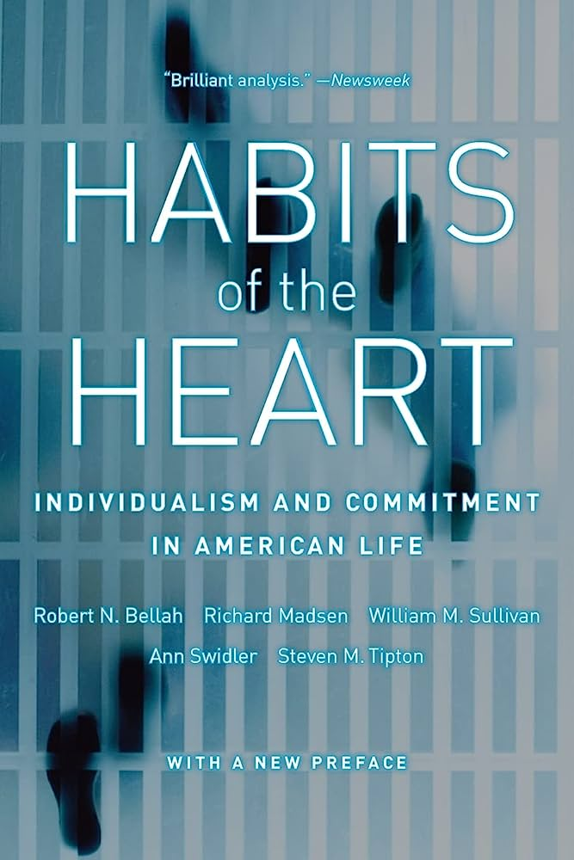
Robert Bellah
(Professor of Sociology at the University of California, Berkeley)
Robert N. Bellah et al., Habits of the Heart (Berkeley: University of California Press, 1996), 333-334.
Expressive individualism holds that each person has a unique core of feeling and intuition
that should unfold or be expressed
if individuality is to be realized.

Slide 7
Charles Taylor
(Canadian Philosopher)
Charles Taylor, A Secular Age (Cambridge, MA: Belknap, 2007), 475.
[The culture of authenticity is one where] each one of us has his/her own way of realizing our humanity…

Slide 8
Charles Taylor
(Canadian Philosopher)
Charles Taylor, A Secular Age (Cambridge, MA: Belknap, 2007), 475.
…It is important to find and live out one’s own [humanity],
as against surrendering to conformity with a model imposed on us from outside, by society, or the previous generation, or religious or political authority.

Slide 9
What is at the core of our identity?
Who am I? Who is the real me? How do I define myself?
Different cultures define identity through various means.
“Expressive individualism”
Identity comes from looking inside our psychological state, rather than outside at the world around us.
Robert N. Bellah et al., Habits of the Heart (1996), 333-334.
“Social imaginary”
Culture of presuppositions and plausibility structures.
Charles Taylor, A Secular Age (2007), 171-172.

Slide 10
Charles Taylor
(Canadian Philosopher)
Charles Taylor, A Secular Age (Cambridge, MA: Belknap, 2007), 171-72.
[The social imaginary refers to] the way ordinary people ‘imagine’ their social surroundings, and this is often not expressed in theoretical terms,
it is carried in images, stories, legends, etc.

Slide 11
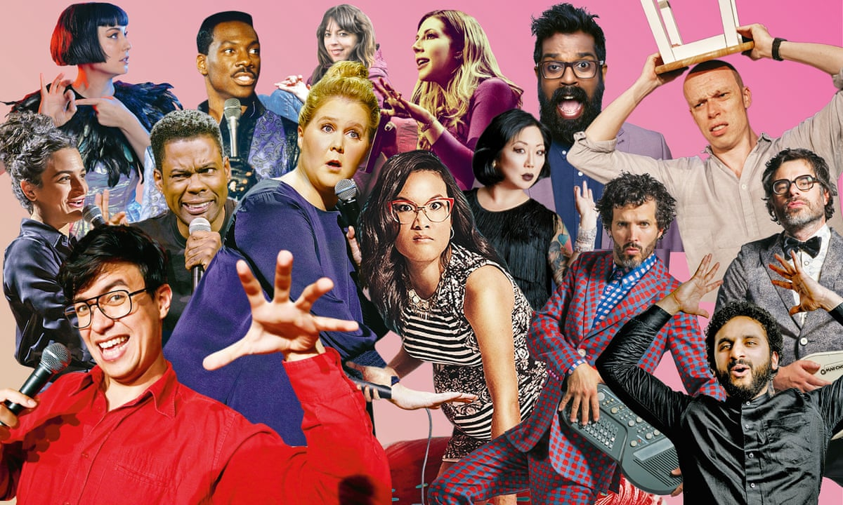
Charles Taylor
(Canadian Philosopher)
Charles Taylor, A Secular Age (Cambridge, MA: Belknap, 2007), 171-72.
[The social imaginary refers to] the way ordinary people ‘imagine’ their social surroundings, and this is often not expressed in theoretical terms,
it is carried in images, stories, legends, etc.

Slide 12
Charles Taylor
(Canadian Philosopher)
Charles Taylor, A Secular Age (Cambridge, MA: Belknap, 2007), 171-72.
What is interesting in the social imaginary is that it is shared by large groups of people, if not the whole society.

Slide 13
Charles Taylor
(Canadian Philosopher)
Charles Taylor, A Secular Age (Cambridge, MA: Belknap, 2007), 171-72.
The social imaginary is that common understanding which makes possible common practices,
and a widely shared sense of legitimacy.

Slide 14
Charles Taylor
(Canadian Philosopher)
Charles Taylor, A Secular Age (Cambridge, MA: Belknap, 2007), 171-72.
Assumed Cultural Norms
“Would you rather…
…be considered unpatriotic…
…or racist?”
The social imaginary is that common understanding which makes possible common practices,
and a widely shared sense of legitimacy.

Slide 15
Summary
We create our identity by looking inside of ourselves—not outside.
e.g. core feelings, intuitions, and desires.
Authenticity requires resisting conformity to outside influences.
Cultural, moral, religious, political, or divine.
Challenging the psychological self is oppressive.
Authenticity demands outward expression of this inner identity.
What is at the core of our identity?
Who am I? Who is the real me? How do I define myself?
Different cultures define identity through various means.
“Expressive individualism”
Identity comes from looking inside our psychological state, rather than outside at the world around us.
Robert N. Bellah et al., Habits of the Heart (1996), 333-334.
“Social imaginary”
Culture of presuppositions and plausibility structures.
Charles Taylor, A Secular Age (2007), 171-172.

Slide 16
“Follow your _____.”
“Follow your _______.”
“Follow your _______.”
“Believe in _______.”
“Be true to _______.”
“No _________.”
“You do ____.”
“Age is just a ________________________”

Slide 17
“Follow your _____.”
“Follow your _______.”
“Follow your _______.”
“Believe in _______.”
“Be true to _______.”
“No _________.”
“You do ____.”
“Age is just a ________________________”
heart
dreams
passion
yourself
yourself
judgment
you
haunting existential reality!

Slide 18
Expressing desires is good.
Psalm 37:4
Randy Alcorn, Happiness (Illinois: Tyndale, 2015)
Authenticity: “Be yourself.”
Matthew 6:2-5; 15:7ff; 23:13ff; Romans 12:9
Culture and tradition are quite often wrong.
Matthew 15:3
Mindless conformity on the core issues of life is wrong.
Romans 12:1-2
Not all desires are good.
Jeremiah 17:9-10; James 1:13-15; Proverbs 14:12
Following Christ can be painful (Luke 14:26-35).
“Deny yourself.”
Mark 8:34
Scripture (not self) is our ultimate authority.
2 Timothy 3:16; 2 Peter 1:19-21
We don’t conquer conformity by looking inwards, but upwards.
Romans 12:1-2

Slide 20
Morality?
Defined in psychological and emotional terms.

Slide 21
If moral claims are reduced to psychological feelings,
this would explain why it’s so difficult to discuss moral issues.
Morality?
Defined in psychological and emotional terms.
“When my married boss flirts with her, it is so gross.”
“His boasting makes me sick.”
“It was awkward to hear you having sex in the dorm.”
“His racial slurs show just how ignorant he is.”

Slide 24
Morality?
Defined in psychological and emotional terms.
Truth?
Psychology overrides science, morality, reason, etc.

Slide 25
Academia
“You’re not reading scholars on the subject.”
Psychology
“I can learn everything I need on the Internet.”

Slide 26
Pediatrics
“No peer reviewed study supports that view.”
Psychology
“I feel like this parenting style helps my kid.”

Slide 27
History
“I don’t think that,
and I never said that.”
Psychology
“I was offended by
what you meant.”

Slide 28
Community
“You’re leaving friends & family for two years.”
Psychology
“I won’t be happy unless I take this job opportunity.”

Slide 29
Biology
“I’m only 5 foot
2 inches tall.”
Psychology
“You can be an NBA player if you believe in yourself!”

Slide 30
Biology
“Your body is fully anatomically male.”
Psychology
“I feel like
I’m a woman.”

Slide 31
Architecture
“That pizza shop doesn’t have a basement.”
Psychology
“Pedophiles have babies in that pizza shop basement.”

Slide 32
Ethics
“No fault divorce will likely hurt my kid.”
Psychology
“I’m not happy in this marriage.”

Slide 33
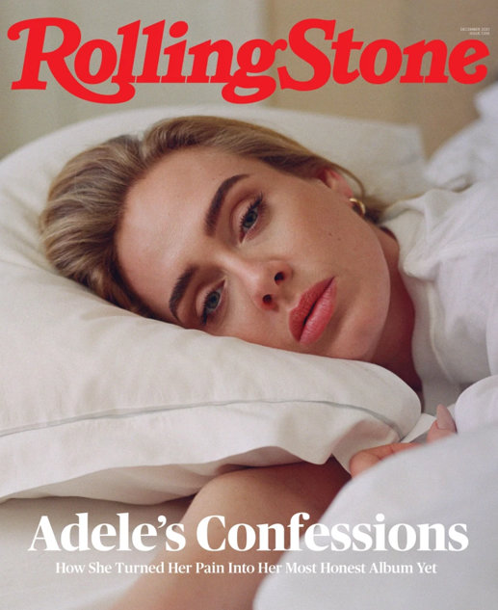
Adele
(English Singer-Songwriter)
Brittany Spanos, “Adele: ‘It F*cking Devastated Me’” Rolling Stone (November 11, 2021).
[Her ex-husband] was a good husband and continues to be a great father to Angelo. He’s still one of Adele’s best friends…

Slide 34
Adele
(English Singer-Songwriter)
Brittany Spanos, “Adele: ‘It F*cking Devastated Me’” Rolling Stone (November 11, 2021).
The end came with the heartbreaking, if less dramatic, feeling that she was getting further from the person she hoped to be.

Slide 35
Adele
(English Singer-Songwriter)
Brittany Spanos, “Adele: ‘It F*cking Devastated Me’” Rolling Stone (November 11, 2021).
“I didn’t really know myself,” she says. “I thought I did… but I just didn’t like who I was.”
Across 30, Adele assesses the most important relationship of her life:
the one with herself.

Slide 36
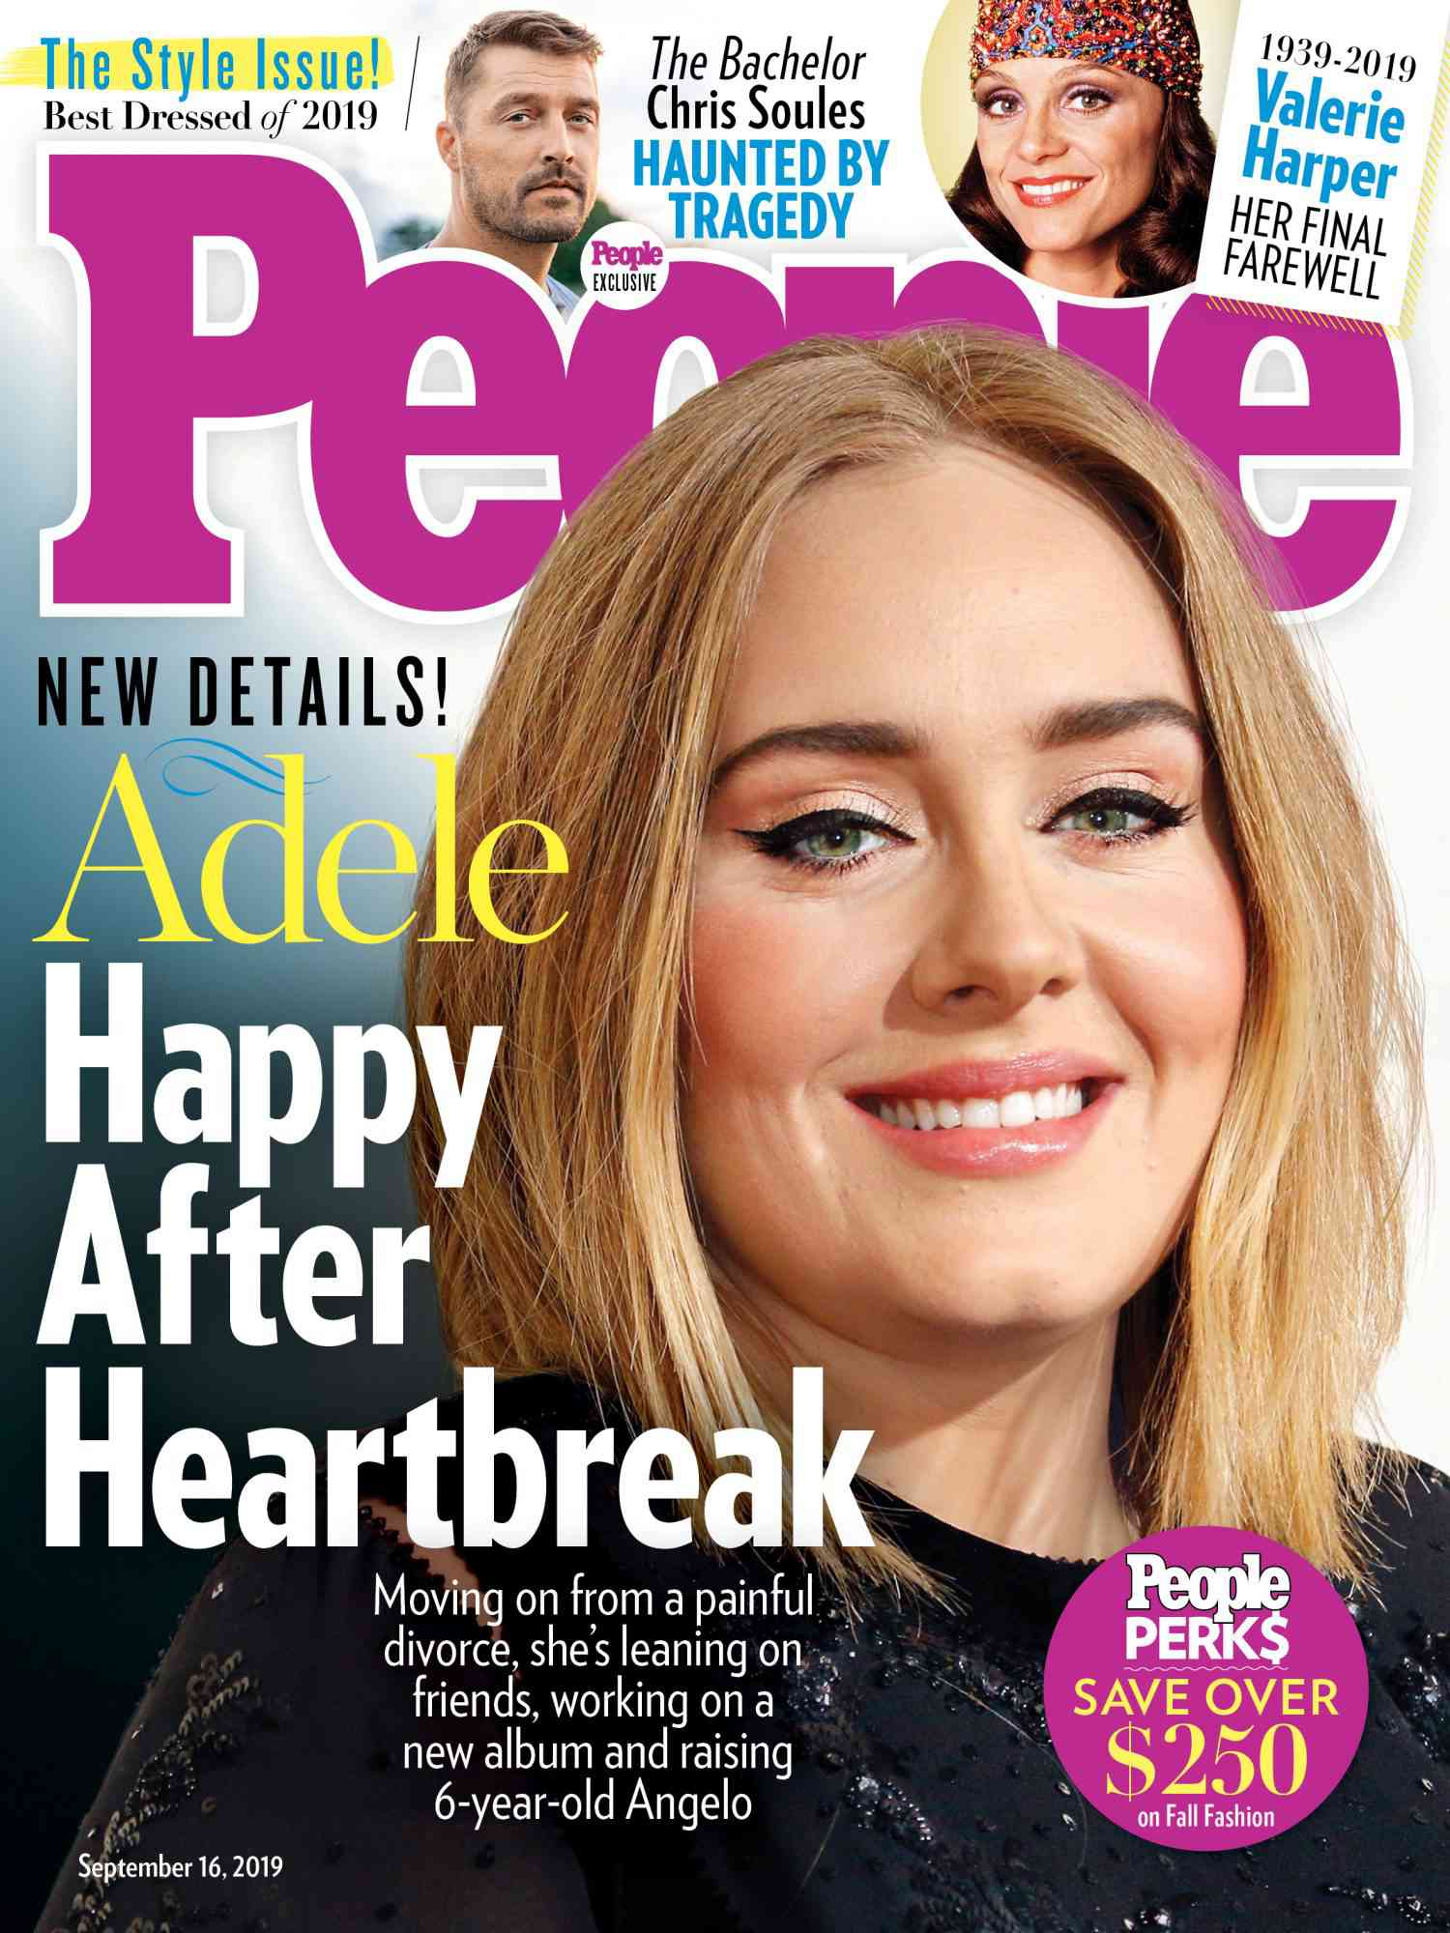
Adele
(English Singer-Songwriter)
Tomás Mier, “Adele Says She ‘Wasn’t Happy’ in Her Marriage with Simon Konecki.” People Magazine (October 7, 2021).
“I was just going through the motions and I wasn’t happy…
Neither of us did anything wrong.”

Slide 37
Adele
(English Singer-Songwriter)
Tomás Mier, “Adele Says She ‘Wasn’t Happy’ in Her Marriage with Simon Konecki.” People Magazine (October 7, 2021).
“Neither of us hurt each other or anything like that. It was just: I want my son to see me really love, and be loved. It’s really important to me.”

Slide 38
Adele
(English Singer-Songwriter)
Tomás Mier, “Adele Says She ‘Wasn’t Happy’ in Her Marriage with Simon Konecki.” People Magazine (October 7, 2021).
“If I can reach why I left, which was the pursuit of my own happiness,
even though it made [my son] really unhappy—if I can find that happiness and he sees me, then maybe I’ll be able to forgive myself.”

Slide 39
Adele
(English Singer-Songwriter)
Tomás Mier, “Adele Says She ‘Wasn’t Happy’ in Her Marriage with Simon Konecki.” People Magazine (October 7, 2021).
Adele, “To Be Loved”
To be loved and love at the highest count
Means to lose all the things I can’t live without
Let it be known that I will choose to lose
It’s a sacrifice but I can’t live a lie
Let it be known, let it be known that I tried
“If I can reach why I left, which was the pursuit of my own happiness,
even though it made [my son] really unhappy—if I can find that happiness and he sees me, then maybe I’ll be able to forgive myself.”

Slide 40
Morality?
Defined in psychological and emotional terms.
Truth?
Psychology overrides science, morality, reason, etc.
Ideological disagreement?
Those who disagree have psychological problems.
If my ideas are my identity, then disagreement attacks me.

Slide 41
Why do insults so often attack a person’s psychology?
Islamophobia, homophobia, transphobia,
nut job, wacko, snowflakes
My ideas = My identity
This is why opposing views are sometimes considered harmful or dangerous.
Morality?
Defined in psychological and emotional terms.
Truth?
Psychology overrides science, morality, reason, etc.
Ideological disagreement?
Those who disagree have psychological problems.
If my ideas are my identity, then disagreement attacks me.

Slide 42
Yet, not true of everyone in our culture…
Morality?
Defined in psychological and emotional terms.
Truth?
Psychology overrides science, morality, reason, etc.
Ideological disagreement?
Those who disagree have psychological problems.
If my ideas are my identity, then disagreement attacks me.

Slide 43
I’ve heard some college campuses where they don’t want to have a guest speaker who is too conservative or they don’t want to read a book if it has language that is offensive to African-Americans or somehow sends a demeaning signal towards women.

Slide 44
I gotta tell you, I don’t agree with that either. I don’t agree that you, when you become students at colleges, have to be coddled and protected from different points of view.

Slide 45
I think you should… have an argument with them.
But you shouldn’t silence them by saying, “You can’t come because I’m too sensitive to hear what you have to say.”
That’s not the way we learn.

Slide 46
I think you should… have an argument with them.
But you shouldn’t silence them by saying, “You can’t come because I’m too sensitive to hear what you have to say.”
That’s not the way we learn.

Slide 51
Morality?
Defined in psychological and emotional terms.
Truth?
Psychology overrides science, morality, reason, etc.
Ideological disagreement?
Those who disagree have psychological problems.
If my ideas are my identity, then disagreement attacks me.
Meaning to life?
Definition: Happiness and authenticity.

Slide 56
Church transfers
Joining where I get the most? Or where I can give the most?
Bible study and prayer?
“I just don’t think God has a good future for me.”
“I don’t know if God is good.” (Psalm 77:11-12)
Conflict and hurt feelings?
Matthew 7:3-5; 1 Corinthians 4:5; 2 Corinthians 7:8
Evangelism?
Matthew 28:18-20; 2 Corinthians 5:20-21

Slide 60
Psychological identity is very fragile
Hypocritical: We hate narcissism, but we preach self-love.
Hypersensitive: magnification, mindreading, labeling, etc.
Contingent: We are dependent on the affirmation of others.
Unhindered freedom is an illusion
Freedoms conflict (e.g. autonomy and intimacy).
Some liberties are devasting (e.g. staying up late).
Some restraints are liberating (e.g. rollercoaster restraint).
Suffering is necessary for joy
Suffering is a means of growth.
Place other people’s needs above our own (Phil. 2:3-4).

Slide 61
“A problem well-defined is half solved.”
But how can we winsomely and effectively win people who are ensnared in this ideology?
(Both inside and outside of Christian community)

Slide 62
